Slide 1
Module 3: Implementing a Machine Learning Pipeline with Amazon SageMaker
AWS Academy Machine Learning Foundations
© 2020, Amazon Web Services, Inc. or its Affiliates. All rights reserved.
Notes:
Welcome to Module 3: Implementing a Machine Learning Pipeline with Amazon SageMaker.

Slide 2

Module overview
Sections
Scenario introduction
Collecting and securing data
Evaluating your data
Preprocessing your data
Training
Evaluating the accuracy of the model
Hosting and using the model
Hyperparameter and model tuning
Demonstration
Training a model using Amazon SageMaker
Optimizing Amazon SageMaker Hyperparameters
Running Amazon SageMaker Autopilot
Knowledge check
Notes:
This module introduces and describes a typical process for handling a machine learning problem. A machine learning pipeline can be applied to many machine learning problems. This module focuses on supervised learning, but the process that you learn in this module can be adapted to other types of machine learning.
This module includes several guided hands-on labs, which enable you to practice what you learn. It also offers a challenge lab where you can explore on your own.
Finally, you will be asked to complete a knowledge check that will test your understanding of key concepts covered in this module.

Slide 3
Module overview continued
Lab
Guided lab: Exploring Amazon Sagemaker
Guided lab: Visualizing data
Guided lab: Encoding categorical data
Guided lab: Splitting data and training a model with xgBoost
Guided lab: Hosting and consuming a model on AWS
Guided lab: Evaluating model accuracy
Guided lab: Tuning with Amazon SageMaker
Challenge Lab:
Notes:
This module introduces and describes a typical process for handling a machine learning problem. A machine learning pipeline can be applied to many machine learning problems. This module focuses on supervised learning, but the process that you learn in this module can be adapted to other types of machine learning.
This module includes several guided hands-on labs, which enable you to practice what you learn. It also offers a challenge lab where you can explore on your own.
Finally, you will be asked to complete a knowledge check that will test your understanding of key concepts covered in this module.

Slide 4
Module objectives
At the end of this module, you should be able to:
Formulate a problem from a business request
Obtain and secure data for machine learning (ML)
Build a Jupyter Notebook using Amazon SageMaker
Outline the process for evaluating data
Explain why data needs to be preprocessed
Use open source tools to examine and preprocess data
Use Amazon SageMaker to train and host an ML model
Use cross-validation to test the performance of an ML model
Use a hosted model for inference
Create an Amazon SageMaker hyperparameter tuning job to optimize a model’s effectiveness
Notes:
At the end of this module, you will be able to:
Formulate a problem from a business request
Obtain and secure data for machine learning (ML)
Build a Jupyter Notebook by using Amazon SageMaker
Outline the process for evaluating data
Explain why data must be preprocessed
Use open source tools to examine and preprocess data
Use Amazon SageMaker to train and host an ML model
Use cross-validation to test the performance of an ML model
Use a hosted model for inference
Create an Amazon SageMaker hyperparameter tuning job to optimize a model’s effectiveness

Slide 5
Section 1: Scenario introduction
Module 3: Implementing a Machine Learning Pipeline with Amazon SageMaker
Notes:
Introducing Section 1: Scenario introduction. You will look at the different datasets that you will use in this module, along with guidance on how to formulate a business problem.

Slide 6
Machine learning pipeline
Section 6
New data and retraining
Deploy model
Business problem
Section 1
Section 8
Problem formulation
Tune model
Yes
Section 2
Section 3
Section 4
Section 5
Section 7
Meets business goal?
Collect and label data
Evaluate data
Feature engineering
Select and train model
Evaluate model
No
Feature augmentation
Data augmentation
Notes:
The machine learning pipeline is the focus of this module. The diagram shows which sections of this module cover each stage in the pipeline.
Section 1 covers problem formulation and the datasets that you will use throughout this module.
Section 2 explains how to obtain and secure data for your machine learning activities.
Section 3 shows you the tools and techniques for understanding your data.
Section 4 deals with preprocessing your data so that it is ready to train a model.
Section 5 is about selecting and training an appropriate machine learning model.
Section 6 shows you how to deploy a module so that you can predict possible outcomes.
Section 7 examines the process of evaluating the performance of a machine learning model.
Section 8 walks you through tuning the model.
The machine learning pipeline is an iterative process. When you work on a real-world problem, you might iterate many times before you find a solution that meets the business needs.

Slide 7
Machine learning pipeline
New data and retraining
Deploy model
Business problem
Problem formulation
Tune model
Yes
Meets business goal?
Collect and label data
Evaluate data
Feature engineering
Select and train model
Evaluate model
No
Feature augmentation
Data augmentation
Notes:
In this first section, you examine how to think about turning a business requirement into a machine learning problem.

Slide 8
Define business objective
What is the business goal?
Questions to ask:
How is this task done today?
How will the business measure success?
How will the solution be used?
Do similar solutions exist, which you might learn from?
What assumptions have been made?
Who are the domain experts?
Notes:
Your first step in this phase is to define the problem that you’re trying to solve and the goal that you want to reach. Understanding the business goal is key, because you use that goal to measure the performance of your solution. You frequently must clarify the business problem before you can begin to target a solution. You must ask other questions so that you can thoroughly understand the problem.

Slide 9
How should you frame this problem?
Is the problem a machine learning problem?
Is the problem supervised or unsupervised?
What is the target to predict?
Do you have access to the data?
What is the minimum performance?
How would you solve this problem manually?
What’s the simplest solution?
Supervised
learning
Unsupervised
learning
Reinforcement
learning
Notes:
With more information about the problem, you can begin to design an approach. First, can machine learning solve the problem, or would a traditional approach make more sense?
Is this problem a supervised or unsupervised machine learning problem? Do you have labeled data to train a supervised model?
Again, you have many questions to ask yourself and the business. Ultimately, you should try to validate the use of machine learning and confirm that you have access to the right people and data. Then, devise the simplest solution to the problem.

Slide 10


Example: Problem formulation
You want to identify fraudulent credit card transactions so that you can stop the transaction before it processes.
Why?
Reduce the number of customers who end their membership because of fraud.
10%
Can you measure it?
Move from qualitative statements to quantitative statements that can be measured.
reduction in fraud claims in retail
Notes:
Consider the following example. You want to identify fraudulent credit card transactions so that you can stop the transaction before it processes. That’s the problem.
What is the business goal or outcome that drives this problem statement? The intended outcome is a reduction in the number of customers who end their membership to the credit card because of a fraudulent transaction.
From a business perspective, how do you define success when you have this problem and intended outcome? At this stage, you must move from qualitative statements to quantitative statements that can be easily measured. Continuing with this example, you might define success for this problem with the following metric: a successful outcome is a 10 percent reduction in the number of customers who file claims for fraudulent transactions within a 6-month period.

Slide 11

Make it an ML model
Credit card transaction is either fraudulent or not fraudulent.
Fraud
Binary classification problem
Not fraud
Use historical data of fraud reports to help define your model.
Notes:
You have now defined the business end of your problem. Next, you start to think about the problem in terms of your machine learning (ML) model. What output do you want to see from your model? Be specific—it should be a statement that reflects what an ML model can output. An example might be: The model will output whether a credit card transaction is fraudulent or not fraudulent.
Now that you know what your ML model should achieve, you can use this information to determine the type of ML that you will work with. If you have historical data where customers filed reports for fraud transactions, you can use this data for your machine learning purpose. This historical data fits into the supervised learning approach, where the labels are given.
Recall from earlier that you categorized supervised ML types into two buckets: classification and regression. In the credit card example, your intended output is to classify a transaction as either fraud or not fraud. Therefore, in this case, you can see that you’re dealing with a binary classification problem.

Slide 12
Wine quality dataset
Question: Based on the composition of the wine, can you predict the quality and therefore the price?
Why:
View statistics
Deal with outliers
Scale numeric data
Citation
Source: UCI Wine quality dataset
Dua, D. and Graff, C. (2019). UCI Machine Learning Repository [http://archive.ics.uci.edu/ml]. Irvine, CA: University of California, School of Information and Computer Science.
P. Cortez, A. Cerdeira, F. Almeida, T. Matos and J. Reis. Modeling wine preferences by data mining from physicochemical properties. In Decision Support Systems, Elsevier, 47(4):547-553, 2009.
Notes:
Throughout this module, you will examine several datasets. These datasets, and more, can be obtained from the UC Irvine Machine Learning Repository at http://archive.ics.uci.edu/ml/index.php.
The first dataset contains numerical information about the composition of wine, along with the quality of the wine. You might use this dataset to ask the question: Based on the composition of the wine, can you predict the quality and therefore the price? You can also use this dataset to view statistics, deal with outliers, and scale numeric data.
More information on this dataset can be found at: https://archive.ics.uci.edu/ml/datasets/wine+quality.
Dataset information
The two datasets are related to red and white variants of the Portuguese Vinho Verde wine. Due to privacy and logistic issues, only physicochemical (inputs) and sensory (the output) variables are available. No data about grape types, wine brand, or wine selling price is available.
Citation
Dua, D. and Graff, C. (2019). UCI Machine Learning Repository [http://archive.ics.uci.edu/ml]. Irvine, CA: University of California, School of Information and Computer Science.
P. Cortez, A. Cerdeira, F. Almeida, T. Matos and J. Reis. Modeling wine preferences by data mining from physicochemical properties. In Decision Support Systems, Elsevier, 47(4):547-553, 2009.

Slide 13
Car evaluation dataset
Question: Can you use a car’s attributes to predict whether the car will be purchased?
Why:
View statistics
Encode categorical data
Citation
Source: UCI Car evaluation dataset
Dua, D. and Graff, C. (2019). UCI Machine Learning Repository [http://archive.ics.uci.edu/ml]. Irvine, CA: University of California, School of Information and Computer Science.
Notes:
The second dataset is a car evaluation database. This dataset is mostly text-based. You can use it to explore encoding categorical data, which converts the text values into numbers that can be processed through machine learning.
More information on the dataset can be found at https://archive.ics.uci.edu/ml/datasets/Car+Evaluation.
Dataset information
Car Evaluation Database was derived from a simple hierarchical decision model. This model was originally developed for the demonstration of DEX, M. Bohanec, V. Rajkovic: Expert system for decision making. Sistemica 1(1), pp. 145-157, 1990.
Dua, D. and Graff, C. (2019). UCI Machine Learning Repository [http://archive.ics.uci.edu/ml]. Irvine, CA: University of California, School of Information and Computer Science.

Slide 14
Vertebral column dataset
Question: Based on the biomechanical features, can you predict whether a patient has an abnormality (disk hernia or spondylolisthesis)?
Why:
View statistics
Encode categorical data
Train and tune a model
Citation
Source: UCI Vertebral column dataset
Dua, D. and Graff, C. (2019). UCI Machine Learning Repository [http://archive.ics.uci.edu/ml]. Irvine, CA: University of California, School of Information and Computer Science.
Notes:
The third dataset is a biomedical dataset, which you will use in the lab. The question to answer is: Based on the biomechanical features, can you predict whether a patient has an abnormality?
You will take this dataset through the entire end-to-end process. You will end with a trained model that is tuned, and that you can use to predict an outcome.
More information on this dataset can be found at: http://archive.ics.uci.edu/ml/datasets/vertebral%2Bcolumn
Dataset information
Dr. Henrique da Mota built this biomedical dataset during a medical residence period. He created it in the Group of Applied Research in Orthopaedics (GARO) of the Centre Médico-Chirurgical de Réadaptation des Massues, Lyon, France.
The data are organized in two different but related classification tasks. The first task consists of classifying patients as belonging to one of three categories: Normal (100 patients), Disk Hernia (60 patients), and Spondylolisthesis (150 patients).
For the second task, the categories Disk Hernia and Spondylolisthesis are merged into a single category that is labeled as abnormal. Thus, the second task consists of classifying patients as belonging to one of two categories: Normal (100 patients) or Abnormal (210 patients).
Citation
Dua, D. and Graff, C. (2019). UCI Machine Learning Repository [http://archive.ics.uci.edu/ml]. Irvine, CA: University of California, School of Information and Computer Science.

Slide 15

Section 1 key takeaways
Business problems must be converted to an ML problem
Why?
Can it be measured?
What kind of ML problem is it?
Classification or regression?
Notes:
Some key takeaways from this section of the module are as follows.
Business problems must be converted into an ML problem. Questions to ask include –
Have we asked why enough times to get a solid business problem statement and know why it is important?
Can you measure the outcome or impact if your solution is implemented?
Most business problems fall into one of two categories –
Classification (binary or multi): Does the target belong to a class?
Regression: Can you predict a numerical value?

Slide 16
Section 2: Collecting and securing data
Module 3: Implementing a Machine Learning Pipeline with Amazon SageMaker
Notes:
Introducing Section 2: Collecting and securing data.

Slide 17
Machine learning pipeline
New data and retraining
Deploy model
Business problem
Problem formulation
Tune model
Yes
Meets business goal?
Collect and label data
Evaluate data
Feature engineering
Select and train model
Evaluate model
No
Feature augmentation
Data augmentation
Notes:
In this section, you will explore some of the techniques and challenges involved with collecting and securing the data that you need machine learning.

Slide 18
What data do you need?
How much data do you have, and where is it?
Do you have access to that data?
What solution can you use to bring all of this data into one centralized repository?
Notes:
Recall the original example about predicting credit card fraud. You formulated the problem. However, what data do you need to train your model to reach the intended output—and subsequently, your specified business outcome? Do you have access to that data? If so, how much data do you have, and where is it? What solution can you use to bring all this data into one centralized repository? Answering these questions is essential at this stage.

Slide 19
Data sources
Private data: Data that customers create
Commercial data: AWS Data Exchange, AWS Marketplace, and other external providers
Open-source data: Data that is publicly available (check for limits on usage)
Kaggle
World Health Organization
U.S. Census Bureau
National Oceanic and Atmospheric Administration (U.S.)
UC Irvine Machine Learning Repository
AWS
Notes:
You can obtain data from several places.
Private data is data that you (or your customers) have in various existing systems. Everything from log files to customer invoice databases can be useful, depending on the problem that you want to solve. In some cases, data is found in many different systems.
Commercial data is data that a commercial entity collected and made available. Companies such as Reuters, Change Healthcare, Dun & Bradstreet, and Foursquare maintain databases that you can subscribe to. These databases include curated news stories, anonymized healthcare transactions, global business records, and location data. Supplementing your own data with commercial data can provide useful insights that you would not have otherwise.
Open-source data comprises many different open-source datasets that range from scientific information to movie reviews. These datasets are usually available for use in research or for teaching purposes. You can find open-source datasets hosted by AWS, Kaggle, and the UC Irvine Machine Learning Repository. Government and health organizations are other sources of data that might be useful.

Slide 20
Observations
ML problems need a lot of data—also called observations— where the target answer or prediction is already known.
Customer | Date of transaction | Vendor | Charge amount | Was this fraud?
ABC | 10/5 | Store 1 | 10.99 | No
DEF | 10/5 | Store 2 | 99.99 | Yes
GHI | 10/5 | Store 2 | 15.00 | No
JKL | 10/6 | Store 2 | 99.99 | ?
MNO | 10/6 | Store 1 | 99.99 | Yes
Feature
Target
Notes:
Supervised machine learning problems need much data—also called observations—for which you know the target answer or prediction. This kind of data is called labeled data. Each observation in your data is made up of two elements: the target and the features. The target is the answer that you want to predict. In the credit card transaction example, the target of any given observation is either fraud or not fraud. A feature is an attribute of the example that can be used to identify patterns to predict the target answer. A feature in the credit card example might be the date of transaction, the vendor, or the amount, in dollars, of the transaction.
You might wonder about the source of the target, fraud or not fraud. Typically, this information is discovered after the transaction is complete and the actual card owner notices a fraudulent transaction on their statement. This information is then recorded with the transaction so it can be used to train a future model.

Slide 21

Get a domain expert
Do you have the data that you need to try to address this problem?
Is your data representative?
Notes:
You now know about the elements of an ML dataset. Recall a previous question: What data do you need to train your model to reach the intended output, and subsequently, your intended business outcome? This example depicts a stage in the ML pipeline when it’s vital to get domain expertise to help you answer this question. With domain knowledge, you can begin to determine the features and target data that your model needs to make accurate predictions.
Your data should be representative of the data that you are going to have when you use the model to make a prediction. For example, if you want to predict credit card fraud, you must collect both positive data (fraudulent transactions) and negative data (non-fraudulent transactions). The ML algorithm must have both types of data so that it can find patterns that distinguish between the two types. For example, suppose that the average amount of fraudulent transactions is actually 3 percent. However, your training dataset includes only a small fraction of fraudulent observations, say 0.4 percent. In this scenario, it might be difficult for your model to correctly learn patterns for fraudulent transactions that it might encounter in production.

Slide 22






Storing data in AWS
Amazon Simple Storage Service (Amazon S3)
Amazon FSx
Amazon Elastic File System (Amazon EFS)
Amazon Relational Database Service (Amazon RDS)
Amazon Redshift
Amazon Timestream
Notes:
AWS has many different services where you can find or store your data. You might use some of the following key services.
Amazon Simple Storage Service (Amazon S3) is object-level storage. Thus, if you want to change part of a stored object or file, you must make the change and then re-upload the entire modified file. Amazon S3 enables you to store as much data as you want, in the aggregate that you want. However, individual objects cannot be larger than 5 TB.
By default, data in Amazon S3 is stored redundantly across multiple facilities and multiple devices in each facility. You can access Amazon S3 through the web-based AWS Management Console or programmatically through application programming interfaces (APIs) and software development kits (SDKs). You can also use third-party solutions (which use APIs and SDKs). Amazon S3 includes event notifications that enable you to set up automatic notifications when certain events occur. An example of such an event might be an object that is uploaded to or deleted from a specific bucket. Those notifications can be sent to you, or they can be used to trigger other processes, such as AWS Lambda scripts.
When your training data is in Amazon S3, you might plan to run training jobs several times with different algorithms and parameters. For these runs, consider trying Amazon FSx for Lustre, a file system service. FSx for Lustre speeds up your training jobs by serving your Amazon S3 data to Amazon SageMaker at high speeds. The first time that you run a training job, FSx for Lustre automatically copies data from Amazon S3 and makes it available to Amazon SageMaker. You can use the same Amazon FSx file system for subsequent iterations of training jobs, which prevents repeated downloads of common Amazon S3 objects.
Alternatively, if your training data is in Amazon Elastic File System (Amazon EFS), you should use it as your training data source. Amazon EFS has the benefit of directly launching your training jobs from the service without the need for data movement. The result is faster training start times. When data scientists have home directories in Amazon EFS, they can quickly iterate on their models. They can bring in new data, share data with colleagues, and experiment with including different fields or labels in their dataset. For example, data scientists can use a Jupyter notebook to do initial cleansing on a training set and launch a training job from Amazon SageMaker. They then can use their notebook to drop a column and re-launch the training job, and they can compare the resulting models to see which one works better.
You might find data in many other places in AWS. These sources include Amazon Relational Database Service (Amazon RDS), Amazon Redshift (which is a managed data warehouse service), and Amazon Timestream. Amazon Timestream is a managed time-series database that is designed specifically to handle large amounts of Internet of Things (IoT) data. You can even spin up your own EC2 instances and host your own database.
You must be able to extract useful data from these sources when you assemble your data for machine learning, which is the next topic.

Slide 23






Extract, transform, load (ETL)
Data Catalog
Crawler
Data Stores
Schedule or Event
Extract
Load
Transform Script
Data Source
Data Target
Notes:
Data is typically spread across many different systems and data providers. The challenge is to bring all these data sources together into something that a machine learning model can consume.
The steps in an extract, transform, and load (ETL) process are defined as follows.
Extract – Pull the data from the sources to a single location.
Transform – During extraction, the data might need to be modified, matching records might need to be combined, or other transformations might be necessary.
Load – Finally, the data is loaded into a repository, such as Amazon S3 or Amazon Athena.
A typical ETL framework has several components. From the diagram, these components include:
Crawler – A program that connects to a data store (source or target). It progresses through a prioritized list of classifiers to determine the schema for your data, and creates metadata tables in the AWS Glue Data Catalog.
Job – The business logic that is required to perform ETL work.
Schedule or event – A scheduling service that periodically runs the ETL process.
Note: The services that are shown exist in the transform partition of the ETL process.

Slide 24

ETL with AWS Glue
Runs the ETL process
Crawls data sources to create catalogs that other systems can query
ML functionality
AWS Glue can glue together different datasets and emit a single endpoint that can queried.
Notes:
AWS Glue is a fully managed ETL service. With AWS Glue, it is simple and cost-effective to categorize your data, clean it, enrich it, and move it reliably between various data stores.
AWS Glue consists of the following components:
A central metadata repository, which is known as the AWS Glue Data Catalog
An ETL engine that automatically generates Python or Scala code
A flexible scheduler that handles dependency resolution, job monitoring, and retries
AWS Glue is serverless, so you don’t have infrastructure to set up or manage.
AWS Glue is designed to work with semistructured data. It introduces a component that is called a dynamic frame, which you can use in your ETL scripts. A dynamic frame is similar to an Apache Spark DataFrame, except that each record is self-describing, so no schema is required initially. With dynamic frames, you get schema flexibility and a set of advanced transformations that are specifically designed for dynamic frames. You can convert between dynamic frames and Spark dataframes. In this way, you can take advantage of both AWS Glue and Spark transformations to do the kinds of analysis that you want.
You can use the AWS Glue console to discover data, transform it, and make it available for search and querying. The console calls the underlying services to orchestrate the work that is required to transform your data. You can also use the AWS Glue API operations to interface with AWS Glue services. You can edit, debug, and test your Python or Scala Apache Spark ETL code in a familiar development environment.
The ML capability references the AWS Glue capability to receive labeled data that can be used for training. One example might be to provide training data that teaches the model what duplicate records would look like in the data source. Then, AWS Glue can identify the duplicates and present them to a data engineer for further analysis.

Slide 25






AWS Glue overview
Amazon S3
AWS Lambda
AWS Glue Data Catalog
Endpoint
Amazon Redshift
AWS Glue
Amazon RDS
Notes:
AWS Glue enables complex ETL jobs to be orchestrated. In the example that is shown, AWS Glue crawls the data sources and presents the information as a data catalog to clients, such as Jupyter.
Event-driven ETL pipelines
AWS Glue can run ETL jobs that are based on an event, such as getting a new dataset. For example, you can use a Lambda function to trigger your ETL jobs to run when new data becomes available in Amazon S3. You can also register this new dataset in the AWS Glue Data Catalog as part of your ETL jobs.

Slide 26
ETL with Python
import boto3, requests, zipfile, os, io url = 'http://url.com/somezipfile.zip‘ folder='./extracts‘
r = requests.get(url, stream=True) thezip = zipfile.ZipFile(io.BytesIO(r.content)) thezip.extractall(folder)
s3 = boto3.client('s3') bucket = 'bucketname'
with os.scandir(folder) as dir: for f in dir: if f.is_file(): s3.upload_file( Filename=os.path.join(folder,f.name), Key=f.name, Bucket=bucket)
Imports and variables
Download and extract
Upload to Amazon S3
Notes:
Although managed tools are available in AWS to manipulate data, data scientists also write scripts in their Jupyter notebook to handle data. A simple extract and load script is shown, which includes:
Imports and variables – This section imports the libraries that are used. Notice that boto3 is the library for AWS. Variables are also set here for the zipfiles web location and a local folder for extraction.
Download and extract – This section makes a web request and saves the bytes from the URL as a stream. This stream is then passed to the ZipFile function, which is then used to extract the data.
Upload to Amazon S3 – With the extracted files in a folder, this section enumerates the folder’s files. It also uploads each file to Amazon S3.
If you find that this script is used often, it should be migrated to a standalone function that Python applications can import.

Slide 27
Securing data: AWS Identity and Access Management (IAM) policy
IAM policies to control access:
{
"Id": "Policy1583974368597",
"Version": "2012-10-17",
"Statement": [
{
"Sid": "Stmt1583974365198",
"Action": ["s3:GetObject"],
"Effect": "Allow",
"Resource": "arn:aws:s3:::awsmachinelearningrepo/*",
"Principal": {"AWS": ["DataReaderRole"]}
}
]
}
GetObject limits access to read only…
…allowing the action…
…for only this bucket…
…by only this IAM role.
Notes:
It’s important to consider the security of your data. The datasets that you use in this course are all public, but real data about customer transactions or health records must be kept secure. The AWS Identity and Access Management (IAM) service controls access to resources. Make sure that you correctly secure your data within AWS to avoid data breaches.
The diagram shows a simple IAM policy that allows only read access to a specific S3 bucket for the specified role.

Slide 28
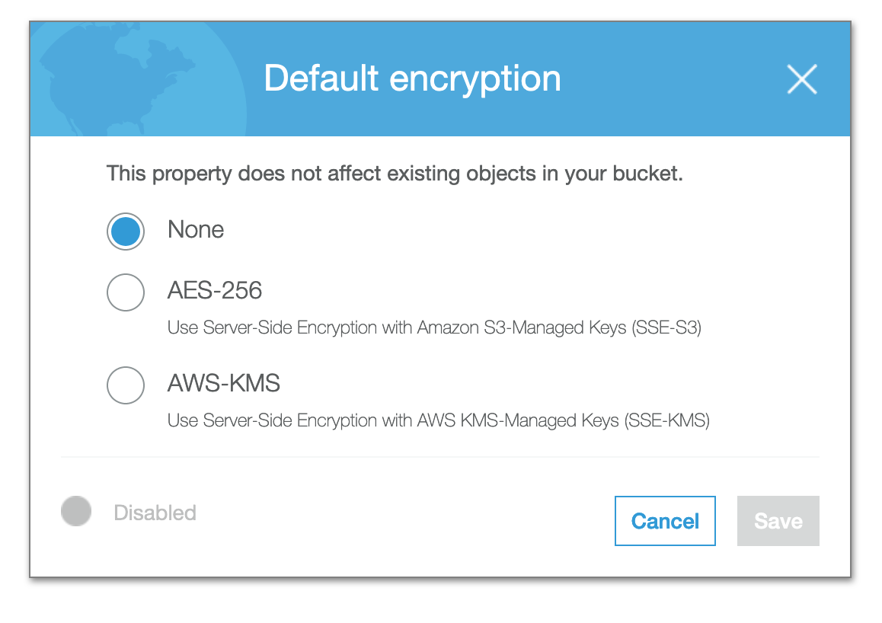
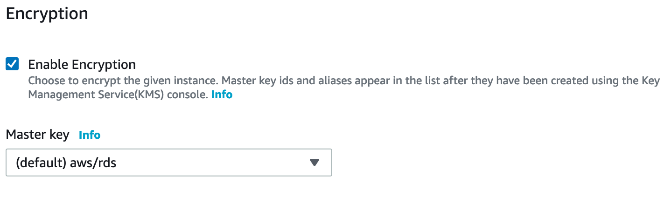
Securing data: Data encryption
The contents of many data repositories in AWS can be quickly and easily encrypted.
Amazon S3 default encryption
Amazon RDS encryption
Notes:
In addition to controlling access to data, you must make sure that your data is secure. It’s a good practice, and it might also be legally required for certain data types, such as financial or healthcare records.
AWS provides encryption features for storage services, typically both at rest and in transit. You can often meet these encryption requirements by enabling encryption on the object or service that you need to protect. For in-transit data, you must use secure transports, such as Secure Sockets Layer/Transport Layer Security (SSL/TLS).

Slide 29
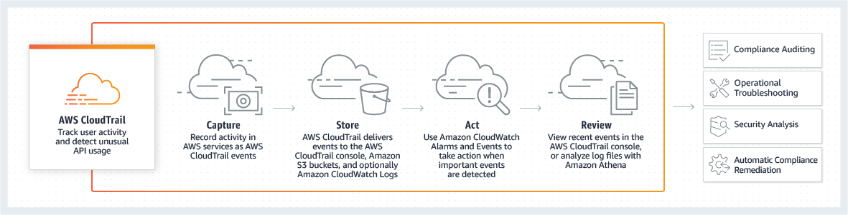
Securing data: AWS CloudTrail for audit
AWS CloudTrail tracks user activity and application programming interface (API) usage.
Compliance Auditing
Operational Troubleshooting
AWS CloudTrail
Track user activity and detect unusual API usage
Capture
Store
Act
Review
Security Analysis
Automatic Compliance Remediation
Notes:
Another aspect to consider is compliance audits. When you work with data from regulated industries, you often must audit access to data. AWS CloudTrail is a service that enables governance, compliance, operational auditing, and risk auditing of your AWS account. With CloudTrail, you can log, continuously monitor, and retain account activity that is related to actions across your AWS infrastructure. CloudTrail provides an event history of your AWS account activity. This activity includes actions that are taken through the AWS Management Console, AWS SDKs, command line tools, and other AWS services. This event history simplifies security analysis, resource change tracking, and troubleshooting. In addition, you can use CloudTrail to detect unusual activity in your AWS accounts. These capabilities help simplify operational analysis and troubleshooting.

Slide 30

Module 3 – Guided Lab 1: Exploring Amazon SageMaker
Notes:
You now complete Module 3 – Guided Lab 1: Exploring Amazon SageMaker.

Slide 31
Section 2 key takeaways
The first step in the machine learning pipeline is to obtain data
Extract, transform, and load (ETL) is a common term for obtaining data for machine learning
AWS Glue makes it easy to run ETL jobs from various data stores
Securing your data includes both controlling access and encrypting data
Notes:
Some key takeaways from this section of the module include:
The first step in solving machine learning problems is to obtain data that is required to train your machine learning model.
ETL can be used to obtain data from multiple sources.
Services such as AWS Glue can make it easy to obtain data from multiple data stores.
Security requirements should be understood, and they should be based on both business need and any regulatory requirements. You want to ensure that your data is secure, only authorized users can access it, and it is encrypted where possible.

Slide 32
Section 3: Evaluating your data
Module 3: Implementing a Machine Learning Pipeline with Amazon SageMaker
Notes:
Introducing Section 3: Evaluating your data.

Slide 33
Machine learning pipeline
Deploy model
New data and retraining
Business problem
Problem formulation
Format data
Tune model
Yes
Examine data types
Perform descriptive statistics
Meets business goal?
Collect and label data
Evaluate data
Feature engineering
Select and train model
Evaluate model
Visualize data
No
Feature augmentation
Data augmentation
Notes:
In this section, you learn how to evaluate data for machine learning. You look at different data formats and types, and how you can visualize and analyze the data before feature engineering.

Slide 34
You must understand your data
Before you can run statistics on your data, you must ensure that it’s in the right format for analysis.
Customer | Date of Transaction | Vendor | Charge Amount | Was This Fraud?
ABC | 10/5 | Store 1 | 10.99 | No
DEF | 10/5 | Store 2 | 99.99 | Yes
GHI | 10/5 | Store 2 | 15.00 | No
JKL | 10/6 | Store 2 | 99.99 | ?
MNO | 10/6 | Store 1 | 99.99 | Yes
“Customer:ABC,DateOfTransation:10/5,Vendor:Store1,ChargeAmount:10.99,WasThisFruad:No…”
Notes:
Before you can run statistics on your data to better understand it, you must ensure that it’s in the right format for analysis. For Amazon SageMaker, algorithms support training with data in comma-separated values (CSV) format. Many of the tools that you use to explore, visualize, and analyze the data can also read the data in CSV format.
In general, you must have at least some domain knowledge for the problem that you are trying to solve with machine learning. To develop a model that predicts whether a set of symptoms indicates a disease, you must know the relationship between the symptoms and the disease.
Data generally must be put into numeric form so ML algorithms can use the data to make predictions. In the next section, you will learn about ways that you can convert text data. For now, you will learn how to explore the data and how to gain some insights into the overall set of data.

Slide 35

Loading data into pandas
Reformats data into tabular representation (DataFrame)
Converts common formats like comma-separated values (CSV), JavaScript Object Notation (JSON), Excel, Pickle, and others
import pandas as pd
url = "https://somewhere.com/winequality-red.csv"
df_wine = pd.read_csv(url,';')
Notes:
One of the more popular open-source Python libraries is pandas. It can reformat data from various formats like CSV, JavaScript Object Notation (JSON), Excel, Pickle, and others into a tabular representation of your data in rows and columns. In addition, pandas has data analysis and manipulation features, which you will use throughout this module.
By using pandas, you can load data in many different formats such as CSV, JSON, Excel, and Pickle.
Loading data can be as simple as the example, which retrieves the CSV file from the URL that is specified.

Slide 36
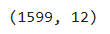
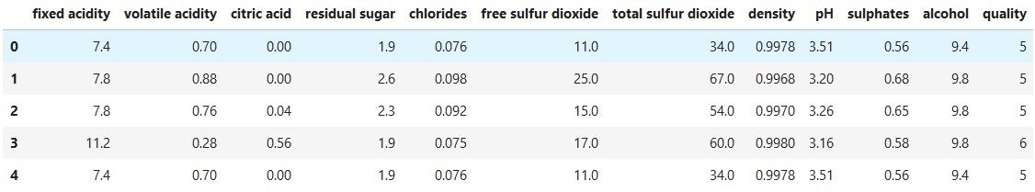
pandas DataFrame
Number of instances
df_wine.shape
Number of attributes
df_wine.head(5)
Columns/Attributes
Rows/Instances
Notes:
When you load data into pandas, it is stored as a pandas DataFrame. The Getting started > Package overview section of the pandas documentation describes a DataFrame as a “General 2D labeled, size-mutable tabular structure with potentially heterogeneously-typed column.” A more helpful way to think of a DataFrame would be like a spreadsheet or SQL table with instances (or rows) and attributes (or columns).
The shape attribute of a DataFrame describes the number of instances (rows) and attributes (columns).
Each column in a DataFrame is a series. A series is a one-dimensional labeled array. A series can store data of any type.
For more information about pandas data structures, see pandas data structures introduction.

Slide 37
Index and column names
df_wine.columns
Index(['fixed acidity', 'volatile acidity', 'citric acid', 'residual sugar',
'chlorides', 'free sulfur dioxide', 'total sulfur dioxide', 'density',
'pH', 'sulphates', 'alcohol', 'quality'],
dtype='object')
df_wine.index
RangeIndex(start=0, stop=1599, step=1)
Notes:
Along with data, you can load a DataFrame with an index (row labels) and columns (column labels). If you load the data from a CSV with a header row, the columns are created from the first line of the file. However, you can change that behavior.
If you don’t have column names in the source file, you can pass them as a parameter (as demonstrated in the following code). If you have no axis labels, then the columns are ordered in the insertion order (for Python versions later than version 3.6 and pandas versions later than version 0.23). For lower versions, the columns are a lexically ordered list of dict keys.
url = "https://archive.ics.uci.edu/ml/machine-learning-databases/car/car.data"
df_car = pd.read_csv(url,',',
names=['buying','maint','doors','persons','lug_boot','safety','class'])

Slide 38
DataFrame schema
df_wine.dtypes
df_wine.info()
quality int64
fixed acidity float64
volatile acidity float64
citric acid float64
residual sugar float64
chlorides float64
free sulfur dioxide float64
total sulfur dioxide float64
density float64
pH float64
sulphates float64
alcohol float64
dtype: object
<class 'pandas.core.frame.DataFrame'>
Int64Index: 1597 entries,
0 to 1598
Data columns (total 12 columns):
quality 1597 non-null int64
fixed acidity 1597 non-null float64
volatile acidity 1597 non-null float64
citric acid 1597 non-null float64
residual sugar 1597 non-null float64
chlorides 1597 non-null float64
free sulfur dioxide 1597 non-null float64
total sulfur dioxide 1597 non-null float64
density 1597 non-null float64
pH 1597 non-null float64
sulphates 1597 non-null float64
alcohol 1597 non-null float64
dtypes: float64(11), int64(1)
memory usage: 162.2 KB
Notes:
When you perform data analysis, it is important to make sure that you use the correct data types. In many cases, pandas correctly infers the correct data types when it loads data, and you can continue.
If you have domain knowledge, or access to a domain expert, they can often spot data-type issues.
You can use either dtypes or info() to obtain information about the column types, like these examples.
If you don’t have the correct data types, then you must work out the reason. Often, it can be a numeric column that has missing data, or a single text value. For example, in the car dataset, the number of doors can be 2, 3, 4, 5, or more. After you analyze the data, you can convert it by using astype:
df_data[‘col’] = df_data[‘col’].astype(‘int’)
In the example, you convert the column that is named col into the type int, and replace the column within the DataFrame df_data.

Slide 39



Descriptive statistics
Use descriptive statistics to gain insights into your data before you clean the data:
Overall statistics
Multivariate statistics
Attribute statistics
Notes:
Now that you have your data in a format that is readable, you can perform descriptive statistics on the data to better understand it. Descriptive statistics give you valuable insight into your data so that you can more effectively preprocess the data and prepare it for your ML model. Next, you will look at how you can use descriptive statistics and why it’s so important.
Descriptive statistics can be organized into different categories. Overall statistics include the number of rows (instances) and the number of columns (features or attributes) in your dataset. This information, which relates to the dimensions of your data, is important. For example, it can indicate that you have too many features, which can lead to high dimensionality and poor model performance.
Attribute statistics are another type of descriptive statistic, specifically for numeric attributes. They give a better sense of the shape of your attributes, including properties like the mean, standard deviation, variance, minimum value, and maximum value.
Multivariate statistics look at relationships between more than one variable, such as correlations and relationships between your attributes.
For cases when you have multiple variables or features, you might want to look at the correlations between them. It’s important to identify correlations between attributes because high correlation between two attributes can sometimes lead to poor model performance. When features are closely correlated and they are all used in the same model to predict the response variable, you might have problems. For example, the model loss might not converge to a minimum state. Be aware of highly correlated features in your dataset.

Slide 40
Statistical characteristics
df_wine.describe()
 | fixed acidity | volatile acidity | citric acid | residual sugar | chlorides | free sulfur dioxide | total sulfur dioxide | pH | sulphates | alcohol | quality
count | 1599.00 | 1599.00 | 1599.00 | 1599.00 | 1599.00 | 1599.00 | 1599.00 | 1599.00 | 1599.00 | 1599.00 | 1599.00
mean | 8.32 | 0.53 | 0.27 | 2.54 | 0.09 | 15.87 | 46.47 | 3.31 | 0.66 | 10.42 | 5.64
std | 1.74 | 0.18 | 0.19 | 1.41 | 0.05 | 10.46 | 32.90 | 0.15 | 0.17 | 1.07 | 0.81
min | 4.60 | 0.12 | 0.00 | 0.90 | 0.01 | 1.00 | 6.00 | 2.74 | 0.33 | 8.40 | 3.00
25% | 7.10 | 0.39 | 0.09 | 1.90 | 0.07 | 7.00 | 22.00 | 3.21 | 0.55 | 9.50 | 5.00
50% | 7.90 | 0.52 | 0.26 | 2.20 | 0.08 | 14.00 | 38.00 | 3.31 | 0.62 | 10.20 | 6.00
75% | 9.20 | 0.64 | 0.42 | 2.60 | 0.09 | 21.00 | 62.00 | 3.40 | 0.73 | 11.10 | 6.00
max | 15.90 | 1.58 | 1.00 | 15.50 | 0.61 | 72.00 | 289.00 | 4.01 | 2.00 | 14.90 | 8.00
Notes:
Mean and median are two different measures that describe the extent that your data is clustered around some value or position.
Mean can be a useful method for understanding your data when the data is symmetrical.
However, your data might be skewed, or it might contain outliers. In that case, the median tends to provide the better metric for understanding your data as it relates to central tendency. For instance, your data might contain outliers with large values. Large outliers can skew the mean one way so that it doesn’t serve as an accurate representation of where your values are truly centered. Outliers don’t affect the median in the same way. You will learn more about outliers soon.
Statistics are available and can be viewed on numerical data by using methods such as describe().
You can also view statistics on a single column by using mean(), median(), min(), max(), skew(), and describe(). For example, to find the mean for sulphates you can use mean():
df_wine[‘sulphates’].mean()
Statistics can also be calculated for multiple columns at a time:
df_wine[[‘sulphates’,’alcohol’]].mean()
To calculate the number of records for a category in a column, you can use value_counts():
df_wine["quality"].value_counts()
pandas can also calculate statistics for each category in a column. This calculation can be done with the groupby() method, as follows:
df_wine.groupby(“quality”)[“sulphates”].mean()

Slide 41
Categorical statistics identify frequency of values and class imbalances
df_car.head(5)
 | buying | maint | doors | persons | lug_boot | safety | class
0 | vhigh | vhigh | 2 | 2 | small | low | unacc
1 | vhigh | vhigh | 2 | 2 | small | med | unacc
2 | vhigh | vhigh | 2 | 2 | small | high | unacc
3 | vhigh | vhigh | 2 | 2 | med | low | unacc
4 | vhigh | vhigh | 2 | 2 | med | med | unacc
df_car.describe()
 | buying | maint | doors | persons | lug_boot | safety | class
count | 1728 | 1728 | 1728 | 1728 | 1728 | 1728 | 1728
unique | 4 | 4 | 4 | 3 | 3 | 3 | 4
top | low | low | 2 | 2 | big | low | unacc
freq | 432 | 432 | 432 | 576 | 576 | 576 | 1210
Notes:
For categorical attributes, you can look at the frequency of attribute values in your dataset. That information will give you some idea about what is inside that categorical variable.
The tables display data from the car dataset, which is made up of several categorical values: buying, maint, lug_boot, safety, and class. Safety can be low, med or high. From the describe() function, you can see that it has three unique values, and low is the most frequent. In the class column, it appears that the top value of the 4 is unacc. It accounts for 1210 of the 1728 values (70 percent), which might suggest an imbalance.
For a target variable that is also of categorical type, the class distribution can indicate whether your dataset has a class imbalance. Imbalanced data can mark a disproportionate ratio of your classes. For instance, suppose that your dataset is made up of credit card transactions, but only a tenth of a percent is labeled as fraud. In this case, your algorithm might not learn adequately to predict examples of credit card fraud.

Slide 42
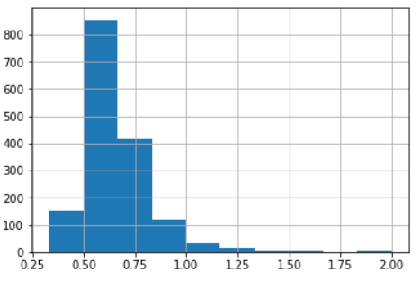
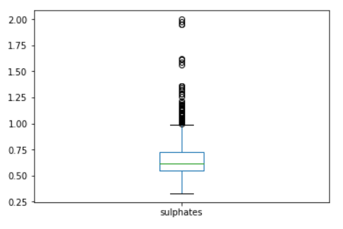
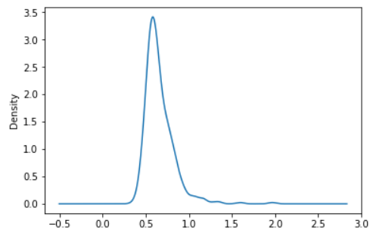
Plotting attribute statistics
df_wine[‘sulphates’].hist(bins=10)
df_wine[‘sulphates’].plot.box()
df_wine[‘sulphates'].plot.kde()
Notes:
A histogram is often a good visualization technique for seeing the overall behavior of a particular feature. With a histogram, you can answer questions, such as: Is the feature data normally distributed? How many peaks are in the data? Does that particular feature have any skewness?
When you use histograms for your data visualization, values are binned. Binning is a technique that you will learn about in a later module on feature engineering. The taller peaks of the histogram indicate the most common values.
In addition to histograms, you can use density plots and box plots for numerical features so that you can get an idea of what’s inside that particular feature. Like a histogram, these visualizations help you answer questions, like: What’s the range of the data? The peak of the data? Does it have any outliers? Does it have any special features? Answering these questions can help you understand your data better. They can also help you decide whether you must do some more specialized data preprocessing.
A box plot is a method for graphically depicting groups of numerical data through their quartiles. The box extends from the Q1 to Q3 quartile values of the data, with a line at the median (Q2). Values outside that range are represented by the lines that extend from the box. These lines are sometimes called whiskers.
The whiskers extend from the edges of box to show the range of the data. The position of the whiskers is set by default to 1.5*IQR (IQR = Q3 - Q1) from the edges of the box. Outlier points are those points that are past the end of the whiskers.

Slide 43
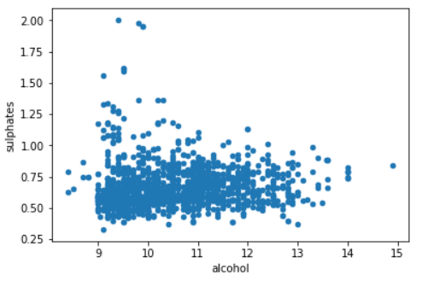
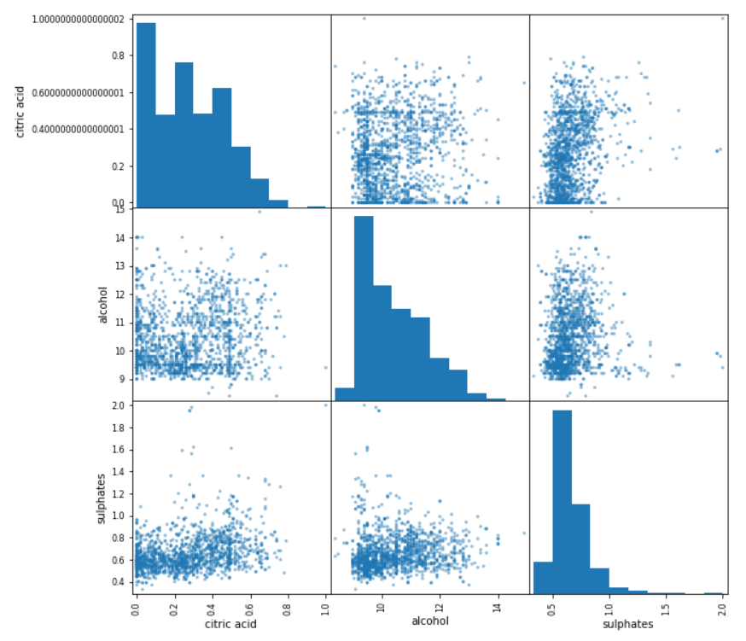
Plotting multivariate statistics
df_wine.plot.scatter(
x='alcohol',
y='sulphates')
pd.plotting.scatter_matrix(
df_wine[['citric acid',
'alcohol',
'sulphates']])
Notes:
When you have more than two numerical variables in a feature dataset, sometimes you want to look at their relationship. A scatter plot is a good way to spot any special relationships among those variables.
For example, you have Sulphates and Alcohol in the left diagram. Those two variables are numeric, and you want to show their relationship so that the scatter plot can help you visualize that relationship. However, the plots are scattered. The correlation between the two variables might not be high because the data is scattered, but some positive relationships might exist between them.
Scatter plot matrices help you look at the relationship between multiple different features. In pandas, you can easily create scatter plot matrices that are based on the columns that you want to examine. In this case, you have three columns—it will give you the pair-wise scatter plot for any two of the columns.

Slide 44
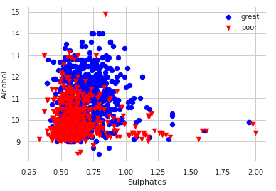
Scatter plot with identification
high = df_wine[['sulphates','alcohol']][df_wine['quality']>5]
low = df_wine[['sulphates','alcohol']][df_wine['quality']<=5]
plt.scatter(high['sulphates'],high['alcohol'],s=50,c='blue',marker='o',label='great')
plt.scatter(x=low['sulphates'],y=low['alcohol'],s=50,c='red',marker='v',label='poor')
Notes:
With a scatter plot, you might want to identify special regions that a particular subset of data belongs to.
Does a relationship exist between alcohol, sulphates, and quality? You can plot out those values against good (quality > 5) and poor (quality <=5) wine, such as in the following example:
high = df_wine[['sulphates','alcohol']][df_wine['quality']>5]
low = df_wine[['sulphates','alcohol']][df_wine['quality']<5]
plt.scatter(high['sulphates'],high['alcohol'],s=50,c='blue',marker='o',label='great')
plt.scatter(x=low['sulphates'],y=low['alcohol'],s=50,c='red',marker='v',label='poor')
plt.xlabel('Sulphates')
plt.ylabel('Alcohol')
plt.legend()
plt.grid()
plt.show()
Plotting gives you an idea of how useful particular variables can be, if you use them for a classification problem.

Slide 45
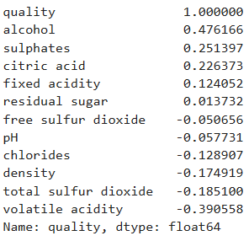
Correlation matrix
corr_matrix = df_wine.corr()
corr_matrix["quality"].sort_values(ascending=False)
Do alcohol and sulphates correlate to wine quality?
Notes:
How can you quantify the linear relationship among the variables that you placed in a scatter plot?
A correlation matrix is a good tool in this situation, because it conveys both the strong and weak linear relationships among numerical variables.
Correlation can be as high as one, or as low as minus one. When the correlation is one, it means that those two numerical features are perfectly correlated with each other. It's like saying that Y is proportional to X. When the correlation of those two variables is minus one, it’s like saying that Y is proportional to minus X. Any linear relationship in between can be quantified by using the correlation. If the correlation is zero, it means that no linear relationship exists, but it does not mean that no relationship exists. It's only an indication that the two variables have no linear relationship.

Slide 46
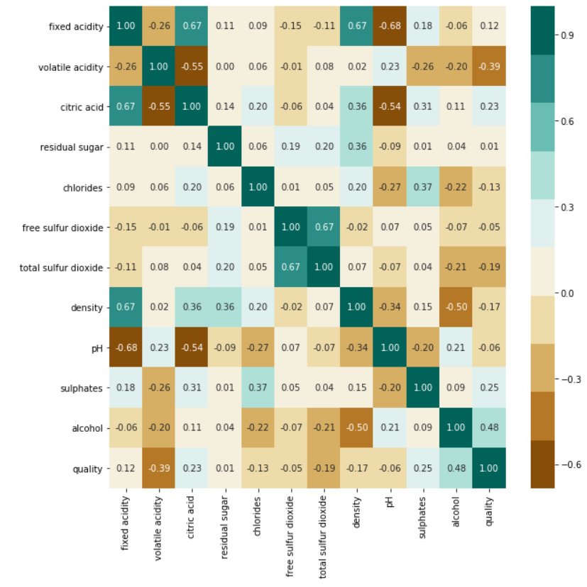
Correlation matrix heat map
import seaborn as sns
correlations = df_wine.corr()
fig, ax = plt.subplots(figsize=(10, 10))
colormap =
sns.color_palette("BrBG", 10)
sns.heatmap(correlations,
cmap=colormap,
annot=True,
fmt=".2f")
ax.set_yticklabels(colum_names);
plt.show()
Notes:
However, looking at a number is not always straightforward. It is often easier to view the numbers if they are represented with colors. Now, consider a heat map. You have the highest number (which is 1) in dark green, and –1 in dark brown. The color gives you both the positive and negative directions, and how strong the correlations are. Don’t worry if you cannot see the text in the diagram, the point of the heat map is spotting correlations with the color!
You can use the Seaborn's heat map function to show the correlation matrix.
From the chart, you can see some correlation between citric acid and fixed acidity. You might expect that correlation in wine, because citric acid contributes to the acidity of the wine.
However, little correlation exists between fixed acidity and pH. pH is a measurement of the strength of those acids present, but fixed acidity is a measure of the quantity. In your dataset, no correlation is apparent.

Slide 47
Module 3 – Guided Lab 2: Visualizing Data
Notes:
You will now complete Module 3 – Guided Lab 2: Visualizing Data.

Slide 48
Section 3 key takeaways
The first step in evaluating data is to make sure that it’s in the right format
pandas is a popular Python library for working with data
Use descriptive statistics to learn about the dataset
Create visualizations with pandas to examine the dataset in more detail
Notes:
Some key takeaways from this section of the module include:
The first step is to get your data into a format that can be used easily.
pandas is a popular and useful Python library for working with data.
Descriptive statistics help you gain insights into the data.
Use visualizations to examine the dataset in more detail.

Slide 49
Section 4: Feature engineering
Module 3: Implementing a Machine Learning Pipeline with Amazon SageMaker
Notes:
Introducing Section 4: Feature engineering.

Slide 50
Machine learning pipeline
New data and retraining
Deploy model
Business problem
Problem formulation
Tune model
Yes
Meets business goal?
Collect and label data
Evaluate data
Feature engineering
Select and train model
Evaluate model
No
Feature augmentation
Data augmentation
Notes:
In this section, you look at the key task of feature engineering, which selects the columns of data that make the most impact in the model.

Slide 51
Feature selection and extraction
Feature Extraction
Feature Selection
X
X
X
Notes:
Two things can make your models more successful: feature selection and feature extraction or creation.
Feature selection is about selecting the features that are most relevant and discarding the rest. Feature selection is applied to prevent either redundancy or irrelevance in the existing features, or to get a limited number of features to prevent overfitting.
Feature extraction is about building up valuable information from raw data by reformatting, combining, and transforming primary features into new ones. This transformation continues until it yields a new set of data that can be consumed by the model to achieve the goals.

Slide 52
Feature extraction
Invalid values
Wrong formats
Misspelling
Duplicates
Consistency
Rescale
Encode categories
Remove outliers
Reassign outliers
Bucketing
Decomposition
Aggregation
Combination
Transformation
Normalization
Dimensionality reduction
Notes:
Feature extraction covers many activities that range from handling missing data to converting text data into numerical data. Although the list is not exhaustive, it should give you some idea of the data handling that’s needed to get data into a useful state.
Many of the tasks are no different from any other job that works with data. You must make sure that data is in the correct format, with consistent representations of data, spelling, and the like. You might combine data, extract data into multiple columns, or remove them altogether.
Tasks that are specific to machine learning include being be able to convert text columns to numerical values, deciding how to handle outliers, and potentially rescaling your data. In this section, you will learn about some of the more common tasks.

Slide 53
Encoding ordinal data
Categorical data is non-numeric data.
Categorical data must be converted (encoded) to a numeric scale.
Maintenance Costs | Encoding
Low | 1
Medium | 2
High | 3
Very High | 4
Notes:
Most ML algorithms work best with numerical data. Therefore, you must make sure that all columns in your dataset contain numeric data by converting or encoding the data.
You might need to make several passes through the dataset before you can encode it. For example, you might have variability in the text values (for example, some rows might contain both Medium and Med).
If the categorical data has order to it, you can encode the text into numerical values that capture this ordinal relationship. For data that shows maintenance costs, you might encode Low to 1, Medium to 2, High to 3, and Very High to 4.
Tools such as Scikit-learns and pandas can be used to encode your categorical data after you make sure that it is all uniform.

Slide 54
Encoding non-ordinal data
If data is non-ordinal, the encoded values also must be non-ordinal.
Non-ordinal data might need to be broken into multiple categories.
… | Color
… | Red
… | Blue
… | Green
… | Blue
 | Green
… | Red | Blue | Green
… | 1 | 0 | 0
… | 0 | 1 | 0
… | 0 | 0 | 1
… | 0 | 1 | 0
… | 0 | 0 | 1
Notes:
If the categorical data doesn’t have any order to it, then you must break the data into multiple columns. You don’t want to introduce an ordinal relationship to the data that isn’t present. For example, suppose you assign a value of 1 to the first color (like red) and 2 to the next value (like blue). Then, the model might interpret blue as more important than red, because it has a higher numeric value.
A better way is to encode non-ordinal data into multiple columns or features. Think of the new features like a check box. In the example, three features are generated, and 1 represents that the instance has that feature, which is its color.

Slide 55
Cleaning data
Types of data to clean:
Type | Example | Action
Variations in strings | Med. vs. Medium | Convert to standard text
Variations in scale | Number of doors vs. number purchased | Normalize to a common scale
Columns with multiple data items | Safe high maintenance | Parse into multiple columns
Missing data | Missing columns of data | Delete rows or impute data
Outliers | Various
Notes:
In addition to converting string data to numerical data, you must clean your dataset for several other potential problem areas. Before you encode the string data, you must make sure that the strings are all consistent. You also must make sure that variables use a consistent scale. For example, if one variable describes the number of doors in a car, the scale is probably between 2 and 8. If another variable describes the number of cars of a particular type sold in the US state of California, the scale is probably in the thousands.
Some data items might also capture more than one variable in a single value. For example, the dataset might include a variable that combines safety and maintenance into a single variable (safe high-maintenance). If you want to train your ML system for both variables, you must split that variable into two variables.
You might also encounter datasets that are missing data for some variables, and some datasets that include outliers. In this section, you learn techniques for dealing with these types of datasets.

Slide 56

Finding missing data
Missing data makes it difficult to interpret relationships
Causes of missing data –
Undefined values
Data collection errors
Data cleaning errors
Example pandas code to find missing data –
df.isnull().sum() #count missing values for each column
df.isnull().sum(axis=1) #count missing values for each row
Notes:
You might also find that you have missing data. For example, some columns in your dataset might be missing data because of a data collection error. Perhaps data wasn’t collected on a particular feature until the data collection process was well under way. Missing data can make it difficult to accurately interpret the relationship between the related feature and the target variable. Thus, regardless of what caused the data to be missed, it is important that you deal with the issue.
Unfortunately, most ML algorithms can’t deal with missing values automatically. You must use human intelligence to update missing values with something meaningful and relevant to the problem.
Most Python libraries for data manipulation include functions for finding missing data. The following example shows how to use the pandas isnull function to find missing data:
df.isnull().sum() #count missing values for each column
df.isnull().sum(axis=1) #count missing values for each row

Slide 57
Plan for missing values
Before dropping or imputing (replacing) missing values, ask:
What were the mechanisms that caused the missing values?
Are these missing values missing at random?
Are rows or columns missing that you are not aware of?
Notes:
How do you decide whether you should drop or impute missing values? This question is answered in part by better understanding what caused those values to be missing. You also must know how much data the missing values represent within your larger dataset.
For instance, suppose that the missing values are randomly spread throughout your dataset and don’t represent a larger portion of its row or column. In this case, imputation is most likely the better option.
Conversely, you might have a column or row that has a large percentage of missing values. In this case, dropping the entire row or column would be preferred over imputation.

Slide 58
Dropping missing values
Drop missing data with pandas
dropna function to drop rows
df.dropna()
dropna function to drop columns with null values
df.dropna (axis=1)
dropna function to drop a subset
df.dropna(subset=[“buying”])
Notes:
If you decide to drop rows with missing data, you can use built-in functions. For example, the pandas dropna function can drop all rows with missing data, or you can drop specific datavalues by using a subset.

Slide 59
Imputing missing data
First, determine why the data is missing
Two ways to impute missing data –
Univariate: Adding data for a single row of missing data
Multivariate: Adding data for multiple rows of missing data
from sklearn.preprocessing import Imputer
import numpy as np
Arr = np.array([[5,3,2,2],[3,None,1,9],[5,2,7,None]])
imputer = Imputer(strategy='mean’)
imp = imputer.fit(arr)
imputer.transform(arr)
Notes:
As an alternative to dropping missing values, you can impute values for those missing values.
You can impute a missing value in different ways. For categorical variables, you usually replace the missing value with the mean, median, or most frequent values. For numerical or continuous variables, you typically use mean or median.
You can impute either a single row of missing data (univariate) or multiple rows (multivariate) of missing data. Consider the univariate example that is shown. You can use the Scikit-Learn imputer function to impute some missing values. It’s a small dataset, but you do have two missing values.
Here, you use the strategy of mean to impute the missing value. With this strategy, you calculate the mean—the mean of 3 and 2 is 2.5—and impute that value for the missing value.
Some data libraries include an impute package that provides more complex ways to impute data. They might include K nearest neighbor, soft impute, multiple imputation by chain equations, and a few other more advanced imputation methodologies.

Slide 60
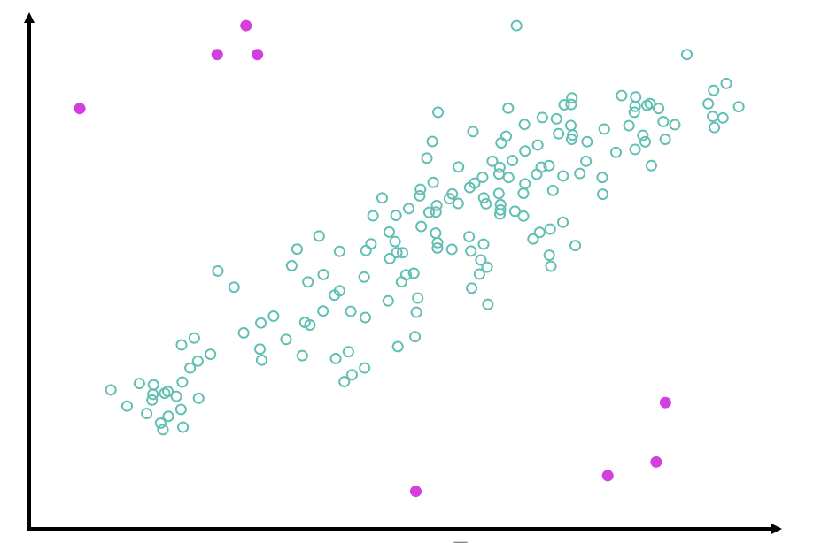
Outliers
Outliers can –
Provide a broader picture of the data
Make accurate predictions difficult
Indicate the need for more columns
Types of outliers –
Univariate: Abnormal values for a single variable
Multivariate: Abnormal values for a combination of two or more variables
Notes:
You might also need to clean your data because of any outliers that might exist. Outliers are points in your dataset that lie at an abnormal distance from other values. They are not always something that you want to clean up, because they can add richness to your dataset. However, they can also make it harder to make accurate predictions. The outliers affect accuracy because they skew values away from the other more normal values that are related to that feature. In addition, an outlier might indicate that the data point belongs to another column.
You can think of outliers as falling into two broad categories. The two categories are a single variation for a single variable (univariate) and a variation of two or more variables (multivariate).

Slide 61
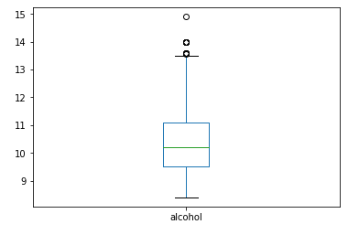
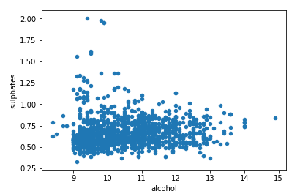
Finding outliers
Box plots show variation and distance from the mean
Example to the right shows a box plot for the amount of alcohol in a collection of wines
Scatter plots can also show outliers
Example to the right shows a scatter plot that shows the relationship between alcohol and sulphates in a collection of wines
Notes:
One of the more common ways to find univariate outliers is with a box plot. A box plot shows how far a data point is from the mean for that variable. The box in the plot shows the data values within two quartiles of the mean.
A scatter plot can be an effective way to see multivariate outliers. For example, this diagram shows the amount of sulphates and alcohol in a collection of wines. With the scatter plot, you can quickly visualize whether multivariate outliers exist for two variables.

Slide 62
Dealing with outliers
Delete the outlier
Transform the outlier
Impute a new value for the outlier
Outlier is based on an artificial error.
Reduces the variation that the extreme outlier value causes and the outlier’s influence on the dataset.
You might use the mean of the feature, for instance, and impute that value to replace the outlier value.
Notes:
The origin of your outlier is likely to determine how you handle it during this preprocessing phase of the pipeline, or later during feature engineering. You can handle outliers with several different approaches. They include, but are not limited to:
Deleting the outlier: This approach might be a good choice if your outlier is based on an artificial error. Artificial error means that the outlier isn’t natural and was introduced because of some failure—perhaps incorrectly entered data.
Transforming the outlier: You can transform the outlier by taking the natural log of a value, which in turn reduces the variation that the extreme outlier value causes. Therefore, it reduces the outlier’s influence on the overall dataset.
Imputing a new value for the outlier: You can use the mean of the feature, for instance, and impute that value to replace the outlier value. Again, this would be a good approach if an artificial error caused the outlier.

Slide 63
Feature selection
Filter method
Use statistical methods
Wrapper methods
Actually train the model
Embedded methods
Integrated with model
Feature Selection
X
X
X
Notes:
After you extract features, you must select the most appropriate features to train your model. Three main feature selection methods are available: filter, wrapper, and embedded.
Filter methods use statistical methods to measure the relevance of features by their correlation with the target variable.
Wrapper methods measure the usefulness of a subset of features by training a model on it and measuring the success of the model.
Filter methods are faster and cheaper than wrapper methods because they do not involve training the models repeatedly. Wrappers typically find the best subset of features, with a risk of overfitting compared to using subsets of features from filter methods.
Embedded methods are algorithm-specific and might use a combination of both.

Slide 64
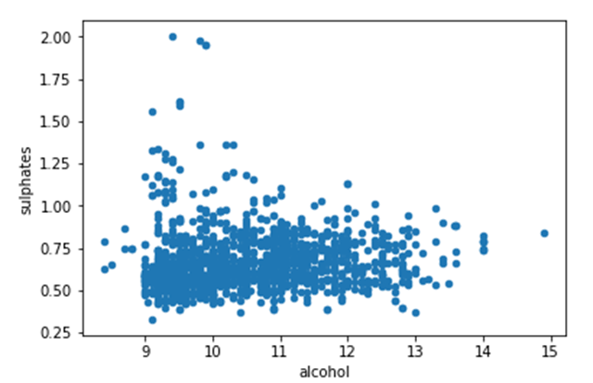
Feature selection: Filter methods
Measures –
Pearson’s correlation
Linear discriminant analysis (LDA)
Analysis of variance (ANOVA)
Chi-square
All features
Statistics and
correlation
Best features
Notes:
Filter methods use a proxy measure instead of the actual model’s performance. Filter methods are fast to compute, and they still capturing the usefulness of the feature set. Common measures include:
Pearson’s correlation coefficient – Measures the statistical relationship or association between two continuous variables.
Linear discriminant analysis (LDA) – Is used to find a linear combination of features that separates two or more classes.
Analysis of variance (ANOVA) – Is used to analyze the differences among group means in a sample.
Chi-square – Is a single number that tells how much difference exists between your observed counts and the expected counts, if no relationship exists in the population.
Filters are usually less computationally intensive than wrappers, but they produce a feature set that is not tuned to a specific type of predictive model. This lack of tuning means that a feature set from a filter is more general than the set from a wrapper. The result is usually lower prediction performance than a wrapper. However, the feature set doesn't contain the assumptions of a prediction model. Thus, it’s more useful for exposing the relationships between the features. Many filters provide a feature ranking instead of an explicit best feature subset, and the cutoff point in the ranking is chosen through cross-validation. Filter methods have also been used as a preprocessing step for wrapper methods, which enables a wrapper to be used on larger problems.

Slide 65
Feature selection: Wrapper
Methods –
Forward selection
Backward selection
All features
Feature subset
Evaluate
results
Train model
Train
?
Best features
Notes:
Wrapper methods use a predictive model to score feature subsets. Each new subset is used to train a model, which is tested on a hold-out set. To get the score for that subset, count the number of mistakes that are made on that hold-out set (the error rate of the model). As wrapper methods train a new model for each subset, they are computationally intensive. However, they usually provide the best-performing feature set for that type of model or typical problem.
Forward selection starts with no features, and adds them until the best model is found.
Backward selection starts with all features, drops them one at a time, and selects the best model.

Slide 66
Feature selection: Embedded methods
Methods –
Decision trees
LASSO and RIDGE
All features
Train model
Feature subset
Evaluate
results
?
Notes:
Embedded methods combine the qualities of filter and wrapper methods. They are implemented from algorithms that have their own built-in feature selection methods.
Some of the most popular examples of these methods are LASSO and RIDGE regression, which have built-in penalization functions to reduce overfitting.

Slide 67
Module 3 – Guided Lab 3: Encoding Categorical Data
Notes:
You will now complete Module 3 – Guided Lab 3: Encoding Categorical Variables.

Slide 68
Section 4 key takeaways
Feature engineering involves –
Selection
Extraction
Preprocessing gives you better data
Two categories for preprocessing –
Converting categorical data
Cleaning up dirty data
Use categorical encoding to convert categorical data
Various types of dirty data –
Missing data
Outliers
Develop a strategy for dirty data –
Replace or delete rows with missing data
Delete, transform, or impute new values for outliers
Notes:
Some key takeaways from this section of the module include:
Feature engineering involves selecting or extracting the best features for machine learning.
Preprocessing gives you better data to work with. Better data typically provides better results.
Preprocessing has two categories:
Converting data (to numerical values)
Cleaning up dirty data (removing missing data, cleaning outliers)
How you deal with dirty data affects your model, pay attention to missing data and outliers.
Develop a strategy for dirty data. Replace or delete rows with missing data.
Delete, transform, or impute new values for outliers.

Slide 69
Section 5: Training
Module 3: Implementing a Machine Learning Pipeline with Amazon SageMaker
Notes:
Introducing Section 5: Training.

Slide 70
Machine learning pipeline
New data and retraining
Deploy model
Business problem
Problem formulation
Tune model
Yes
Meets business goal?
Collect and label data
Evaluate data
Feature engineering
Select and train model
Evaluate model
No
Feature augmentation
Data augmentation
Notes:
In this section, you will learn how to select a model and train it with the data that you preprocessed.

Slide 71
File formats for machine learning
*.csv
*.rec
JSON
lines
text
Protobuf
recordIO
Notes:
You have done much to clean and prepare your data, but your data still might not be ready to train the algorithm. Some algorithms require your data to be in a specific format. You should be aware of the following formatting steps as a way to prepare for model training.
Some algorithms might not be able to work with training data in a DataFrame format. In general, the data that you use for ML training can be stored in various formats, depending on your use case and algorithm. Various algorithms commonly use some file formats, such as CSV. Many Amazon SageMaker algorithms support training with data in CSV format. For use with Amazon SageMaker, CSV files can’t have a header record, and the target variable must be in the first column.
Most Amazon SageMaker algorithms work best when you use the optimized protobuf recordIO format for the training data. In the protobuf recordIO format, Amazon SageMaker converts each instance in the dataset into a binary representation as a set of 4-byte floats, then loads it in the protobuf values field. This format enables you to take advantage of Pipe mode when you train the algorithms that support it. In Pipe mode, your training job streams data directly from Amazon S3. In contrast, File mode loads all your data from Amazon S3 to the training instance volumes. Streaming with Pipe mode can provide faster start times for training jobs and better throughput. You can also reduce the size of the Amazon Elastic Block Store (Amazon EBS) volumes for your training instances because pipe mode needs only enough disk space to store your final model artifacts. In contrast, File mode needs disk space to store both your final model artifacts and your full training dataset.
The target variable in your training dataset should be the first column on the left. Your features should be to the right of the target variable column.

Slide 72
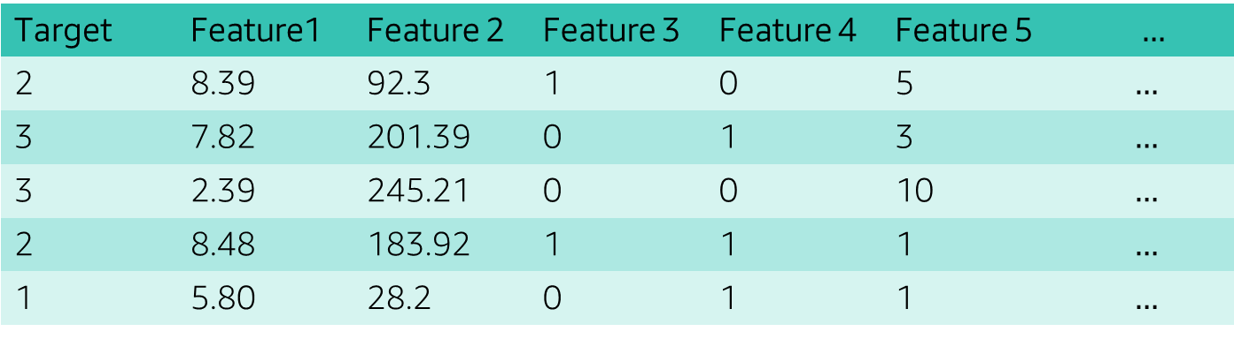
Formatting the data for an algorithm
When you use CSV format, use the first column as the target variable.
Target | Feature1 | Feature 2 | Feature 3 | Feature 4 | Feature 5 | $$…$$
2 | 8.39 | 92.3 | 1 | 0 | 5 | $$…$$
3 | 7.82 | 201.39 | 0 | 1 | 3 | $$…$$
3 | 2.39 | 245.21 | 0 | 0 | 10 | $$…$$
2 | 8.48 | 183.92 | 1 | 1 | 1 | $$…$$
1 | 5.80 | 28.2 | 0 | 1 | 1 | $$…$$
*.csv
Notes:
The target variable in your training dataset should be the first column on the left. Your features should be to the right of the target variable column.

Slide 73
Why split the data?
Y
All data that is used for training and evaluation
X
Overfitting
Notes:
Evaluating a model with the same data that it trained on leads to overfitting. Recall that overfitting is where your model learns the particulars of a dataset too well. It essentially memorizes the training data, instead of learning the relationships between features and labels. Thus, the model can’t use those relationships and patterns to apply to new data in the future.

Slide 74
Holdout method
10% - Test data
10% - Validation data
80% - Training data
Notes:
Hold-out is when you split your data into multiple sets. These sets are usually training data, validation data, and testing data.
Training data, which includes both features and labels, feeds into the algorithm that you selected to produce your model. The model is then used to make predictions over the validation dataset. The validation dataset is where you might notice things that you will want to tweak, tune, and change. Then, when you are ready, you run the test dataset—which includes only features, because you want the labels to be predicted. The performance you get here with the test dataset is what you can reasonably expect to see in production.
A common split when you use the hold-out method is as follows: use 80 percent of the data for a training set, 10 percent for validation, and 10 percent for test. Or, if you have a large amount of data, you can split it into 70 percent training, 15 percent validation, and 15 percent test.

Slide 75
K-fold cross validation
Model 1
Model 2
Model 3
Model 4
Model 5
Test
Train
Train
Train
Train
Train
Test
Train
Train
Train
Train
Train
Test
Train
Train
k = 5
Train
Train
Train
Test
Train
Train
Train
Train
Train
Test
Notes:
For a small dataset, you can use k-fold cross validation to use as much data as possible. This technique provides good metrics to choose which model is better. K-fold cross validation randomly partitions the data into K different segments. For each segment, you use the rest of the data outside the segment for training to do a validation on that particular segment.
You do this process for each K segment. You apply different models to different pieces of the validation dataset to have some idea about how well the models perform. As a result, you use all the data for training. The cross-validation results are averaged to give you an idea about the performance of the model. You can use k-fold cross validation to apply different ML models to the training data. Thus, you can compare the performance of the models, which is based on the averaged result.
Consider an example where you have a 5-Fold Cross Validation. The available training data is separated into five different chunks. When you train the first model, you use all those chunks as the training data, and then calculate the metrics on this test piece. For the second model, you will use these pieces as training. After the model is trained, you apply it to this test piece. You repeat this process five times. You use all the training data, and you test it on five different models on different chunks of the test data. Eventually, you test it on all data points.

Slide 76
Shuffle your data
quality | Fixed acidity | sulphates
3 | 7.2 | 0.56
3 | 7.2 | 0.68
4 | 7.8 | 0.65
4 | 7.8 | 0.65
4 | … | …
5 | … | …
5 | … | …
5 | … | …
6 | … | …
6 | … | …
Test data
Training data
Notes:
You should also be aware of one other potential problem with splitting your data. Data that’s in a specific order can lead to biases in your models, and this is especially true when you work with structured data. Your data might be in a specific order, for example, by the quality column. If so, when you run your model against your test data, this ordered pattern is applied, which biases the model. It might also mean that some targets are missing from the training data.
Typically, randomizing your dataset before splitting is sufficient, and many libraries provide functions for randomization. With smaller sets, it is sometimes useful to use stratified sampling. Stratified sampling ensures that the training and test sets have approximately the same percentage of samples of each target class as the complete set.
An internet search provides many ways to shuffle and split the data. One of the easiest ways is to use the train_test_split function from sklearn.
from sklearn.model_selection import train_test_split
training_data, test_data = train_test_split(all_the_data, test_size=0.2, random_state=42, stratify=all_the_data[target’])
Note: The use of stratify ensures that the data—when it’s split—maintains the ratio in the target column.

Slide 77

Training models with Amazon SageMaker
Amazon SageMaker provides ML algorithms that are optimized for speed, scale, and accuracy.
Amazon SageMaker built-in algorithms
Amazon SageMaker supported frameworks
Amazon SageMaker custom frameworks
AWS Marketplace algorithms
Notes:
Amazon SageMaker provides four different ways that you can train models.
Amazon SageMaker built-in algorithms – You can train and deploy these algorithms from Amazon SageMaker console, AWS Command Line Interface (AWS CLI), a Python notebook, or the Amazon SageMaker Python SDK. The available built-in algorithms are itemized and described in the next slide. Containers are used in the background when you use one of the Amazon SageMaker built-in algorithms, but you do not deal with them directly.
Amazon SageMaker supported frameworks – Amazon SageMaker provides prebuilt containers to support deep learning frameworks such as Apache MXNet, TensorFlow, PyTorch, and Chainer. It also supports ML libraries, such as scikit-learn and SparkML by providing prebuilt Docker images. If you use the Amazon SageMaker Python SDK, they are deployed by using their respective Amazon SageMaker SDK Estimator class. In this case, you supply the Python code that implements your algorithm, and configure the prebuilt image to access your code as an entry point. You might have functional requirements for an algorithm or model that you developed in a framework, which a prebuilt Amazon SageMaker Docker image doesn't support. If so, you can modify an Amazon SageMaker image to satisfy your needs.
Amazon SageMaker custom frameworks – If you have no prebuilt Amazon SageMaker container image to use or modify for an advanced scenario, you can package your own script or algorithm. You can then use this script or algorithm with Amazon SageMaker. You can use any programming language or framework to develop your container. For example, your team might work and build ML models in R. If so, you can build your own containers to train and host an algorithm in R.
AWS Marketplace algorithms – A third-party organization might have developed and tuned a model. It’s worth looking in the AWS Marketplace to see what ready-to-use algorithms and models are available.

Slide 78
Amazon SageMaker built-in algorithms
Classification
Quantitative
Recommendations
Unsupervised
Specialized
XGBoost
XGBoost
Factorization machines
K-means
Image classification
Neural Topic Model (NTM)
Linear learner
Linear learner
Principal Component Analysis
Sequence-to-sequence
Latent Dirichlet Allocation (LDA)
Notes:
Amazon SageMaker provides high-performance, scalable ML algorithms that are optimized for speed, scale, and accuracy.
For supervised learning, Amazon SageMaker includes eXtreme Gradient Boosting (XGBoost) and linear learner algorithms for classification and quantitative (regression) problems. It also has a factorization machine to address recommendation and time-series prediction problems.
Amazon SageMaker also includes support for unsupervised learning, such as k-means clustering and principal component analysis (PCA). This learning is used to solve problems like identifying customer groupings that are based on purchasing behavior.
Finally, it has a selection of specialized algorithms for processing images and other deep learning tasks.
Next, you will look more closely at three of the most commonly used built-in algorithms and their use cases.

Slide 79
XGBoost
Is an open-source implementation of the gradient boosted trees algorithm
Has performed well in machine learning competitions
Robustly handles various data types, relationships, and distributions, and a large number of hyperparameters
Notes:
XGBoost is a popular and efficient open-source implementation of the gradient boosted trees algorithm. Gradient boosting is a supervised learning algorithm that attempts to accurately predict a target variable. It attains its prediction by combining an ensemble of estimates from a set of simpler, weaker models. XGBoost has done well in machine learning competitions. It robustly handles various data types, relationships, and distributions, and the many hyperparameters that can be tweaked and tuned for improved fit. This flexibility makes XGBoost a solid choice for problems in regression, classification (binary and multiclass), and ranking.

Slide 80
Linear learner
Provides a solution for both classification and regression problems
Enables you to simultaneously explore different training objectives and choose the best solution from your validation set
Regression
Binary classification
Notes:
The Amazon SageMaker linear learner algorithm provides a solution for both classification and regression problems. With the Amazon SageMaker algorithm, you can simultaneously explore different training objectives and choose the best solution from your validation set. You can also explore many models and choose the best one for your needs.
The Amazon SageMaker linear learner algorithm compares favorably with methods that provide a solution for only continuous objectives. It provides a significant increase in speed over naive hyperparameter optimization techniques.

Slide 81
K-means
It attempts to find discrete groupings within data, where members of a group are as similar as possible.
The means in k-means is the averaging of the data. This averaging helps to find the center of the grouping.
Notes:
K-means is an unsupervised learning algorithm. It attempts to find discrete groupings within data. In such groupings, members of a group are as similar as possible to one another, and as different as possible from members of other groups. You define the attributes that you want the algorithm to use to determine similarity.

Slide 82

Creating a training job in Amazon SageMaker
2
{
code comes here
code comes here
code comes here
}
{
code comes here
code comes here
code comes here
}
{
code comes here
code comes here
code comes here
}
1
Training code
S3 bucket training data
Helper code
Training code
3
Model training
on ML computer instances
Amazon Elastic Container Registry (Amazon ECR)
Amazon SageMaker
Notes:
To train a model in Amazon SageMaker, you create a training job. The training job includes the following information:
The URL of the Amazon S3 bucket where you stored the training data.
The compute resources that you want Amazon SageMaker to use for model training. Compute resources are ML compute instances that Amazon SageMaker manages. Amazon SageMaker provides a selection of instance types that are optimized to fit different ML use cases. Instance types comprise varying combinations of CPU, GPU, memory, and networking capacity. You have the flexibility to choose the appropriate mix of resources for building, training, and deploying your ML models. Each instance type includes one or more instance sizes, and this feature enables you to scale your resources to the requirements of your target workload.
The URL of the S3 bucket where you want to store the output of the job.
The Amazon Elastic Container Registry (Amazon ECR) path where the training code is stored.

Slide 83
Demonstration: Training a Model Using Amazon SageMaker
Notes:
Your instructor will now either demonstrate how to train a model with Amazon SageMaker or provide you with access to a recorded demonstration.

Slide 84
Module 3 – Guided Lab 4: Splitting Data and Training a Model with XGBoost
Notes:
You will now complete Lab 4: Splitting Data and Training a Model with XGBoost.

Slide 85
Section 5 key takeaways
Split data into training and testing sets –
Optionally, split into three sets, including validation set
Can use k-fold cross validation to use all the non-test data for validation
Can use two key algorithms for supervised learning –
XGBoost
Linear learner
Use k-means for unsupervised learning
Use Amazon SageMaker training jobs
Notes:
Some key takeaways from this section of the module include:
Split data into training, testing and validation sets to help you validate the models accuracy
Can use K-fold cross validation can help with smaller datasets
Can use two key algorithms for supervised learning—XGBoost and linear learner
Use k-means for unsupervised learning
Use Amazon SageMaker training jobs to train models

Slide 86
Section 6: Hosting and using the model
Module 3: Implementing a Machine Learning Pipeline with Amazon SageMaker
Notes:
Introducing Section 6: Hosting and using the model.

Slide 87
Machine learning pipeline
New data and retraining
Deploy model
Business problem
Problem formulation
Tune model
Yes
Meets business goal?
Collect and label data
Evaluate data
Feature engineering
Select and train model
Evaluate model
No
Feature augmentation
Data augmentation
Notes:
In this section, you will learn how you can deploy your trained model for consumption by applications.

Slide 88

Is your model ready to deploy?
Trained
Tuned
Tested
Notes:
After you have trained, tuned, and tested your model, you are ready to deploy it. (Note: You will learn about tuning in the next section.) You might think that you are looking at the phases in the ML pipeline out of order. To test and get performance metrics from your model, you must make inferences or predictions from the model—which typically requires deployment. Deployment for testing is different from production, although the mechanics are the same. Amazon SageMaker provides everything necessary to host your model for simple testing and evaluation. These assessments can involve anything from a few requests to deployments that handle tens of thousands of requests.

Slide 89
Deployment options
Two options for deployment
Amazon SageMaker hosting services
Batch transform
Notes:
You can deploy your model in two ways.
For single predictions, deploy your model with Amazon SageMaker hosting services. Amazon SageMaker deploys multiple compute instances that run your model behind a load balanced endpoint. Applications can call the API at the endpoint to make predictions. With this model, you can scale the number of instances up or down, based on demand.
To get predictions for an entire dataset, use Amazon SageMaker batch transform. Instead of deploy and maintain a permanent endpoint, Amazon SageMaker spins up your model and performs the predictions for the entire dataset that you provide. It stores the results in Amazon S3 before it shuts down and terminates the commute instances. Performing batch predictions when you test the model is useful because you can quickly run your entire validation set against the model. You don’t need to write any code to process and collate the individual results.

Slide 90

The goal of deployment
Predictions
Managed environment hosting models
In production
Notes:
The goal of the deployment phase is to provide a managed environment to host models for providing inference both securely and with low latency. After deployment into production, remember to monitor your production data. If necessary, you must retrain your model, because newly deployed models must reflect the current production data. New data is accumulated over time, and it can potentially identify alternative or new outcomes. Therefore, deploying a model is a continuous process, not a one-time exercise.

Slide 91




Deploying with Amazon SageMaker
Client
Inference
request
Inference
response
Secure endpoint
Amazon SageMaker
Helper
code
Inference
code
Models
Helper
code
Training
code
Training
data
Inference
code images
Notes:
For high availability and redundancy, you can easily deploy your model to automatically scaling Amazon ML instances across multiple Availability Zones. Specify the type of instance, and the maximum and minimum number that you want—Amazon SageMaker takes care of the rest. It launches the instances, deploys your model, and sets up the secure HTTPS endpoint for your application. Your application must include an API call to this endpoint to achieve low latency and high-throughput inference. This architecture enables you to integrate your new models into your application in minutes because model changes no longer require changes to application code.
Amazon SageMaker manages your production compute infrastructure on your behalf. It performs health checks, applies security patches, and conducts other routine maintenance. It does all of these tasks with built-in Amazon CloudWatch monitoring and logging.

Slide 92
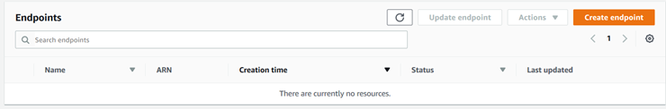
Creating an endpoint
You can create an endpoint in the console:
Or, you can use the Amazon SageMaker SDK:
xgb_predictor = xgb_model.deploy(initial_instance_count=1,
content_type='text/csv',
instance_type='ml.t2.medium'
)
Notes:
After you train the model, you can create the endpoint either in code or by using the Amazon SageMaker console. If you plan to host only a single model, you can create an endpoint for that model. However, if you plan to host multiple models, you must create a multi-model endpoint.
Multi-model endpoints provide a scalable and cost-effective solution for deploying large numbers of models. They use a shared serving container that is enabled to host multiple models. This process reduces hosting costs by improving endpoint utilization, compared to single-model endpoints. It also reduces deployment costs because Amazon SageMaker loads models in memory, and scales them according to traffic patterns.

Slide 93
Obtaining predictions
Data processing steps
Model training
Predictions
Notes:
When you deploy machine learning models into production so you can make predictions on new data, consistency is important. You must ensure that the same data processing steps that were used in training are also applied to each inference request. Otherwise, you might get incorrect prediction results.
By using inference pipelines, you can reuse the data processing steps that were applied in model training to inference. It isn’t necessary to maintain two separate copies of the same code. This reuse of code helps with the accuracy of your predictions and reduces development cost.
Because Amazon SageMaker is a managed service, inference pipelines are completely managed. When you deploy the pipeline model, the service installs and runs the sequence of containers on each EC2 instance in the endpoint, or in the batch transform job. Additionally, the sequence of feature processing and inferences runs with low latency because the containers are collocated on the same EC2 instances.

Slide 94
Module 3 – Guided Lab 5: Hosting and Consuming a Model on AWS
Notes:
You will now complete Module 3 – Guided Lab 5: Hosting and Consuming a Model on AWS.

Slide 95
Section 6 key takeaways
Can use two options for deployment
Amazon SageMaker hosting
Batch transform
Deploy only after you have tested your model
Goal is to generate predictions for client applications
Create an endpoint
Single-model endpoint for simple use cases
Multi-model endpoint to support multiple use cases
Notes:
Some key takeaways from this section of the module include:
You can deploy your trained model by using Amazon SageMaker to handle API calls from applications, or to perform predictions by using a batch transformation.
The goal of your model is to generate predictions to answer the business problem. Be sure that your model can generate good results before you deploy it to production.
Use Single-model endpoints for simple use cases and use multi-model endpoint support to save resources when you have multiple models to deploy.

Slide 96
Section 7: Evaluating the accuracy of the model
Module 3: Implementing a Machine Learning Pipeline with Amazon SageMaker
Notes:
Introducing Section 7: Evaluating the accuracy of the model.

Slide 97
Machine learning pipeline
New data and retraining
Deploy model
Business problem
Problem formulation
Tune model
Yes
Meets business goal?
Collect and label data
Evaluate data
Feature engineering
Select and train model
Evaluate model
No
Feature augmentation
Data augmentation
Notes:
In this section, you will learn how you can evaluate your model’s success in predicting results.

Slide 98
Evaluation determines how well your model predicts the target on future data
Testing and evaluation: To evaluate the predictive quality of the trained model
10% – Test data
10% – Validation data
80% – Training data
Notes:
After you train and tune your models and decide which model is the best for your business problem, you must evaluate your model. You want to determine whether it will perform well in predicting the target on new and future data. Because future instances have unknown target values, you must assess how the model will perform on data for which you know the target answer. Then, use this assessment as a proxy for performance on future data. For this reason, you hold out a sample of your data for evaluation or testing purposes.

Slide 99
Success metric
Business problem: Fraudulent credit card transactions
Success metric:
10% reduction in fraud claims in 6-month period
Model metric
The model metric must align to both the business problem and the success metric.
Notes:
An important part of this phase is to choose the most appropriate metric for your business situation. Think back to the earlier section on problem formulation. During that phase, you defined your business problem and outcome, and you crafted a business metric to evaluate success. The model metric that you choose at this phase should be linked to that business metric as closely as possible. Frequently, the two metrics have a high correlation.
In addition to considering your business problem and success metric, the type of ML problem you work with influences the model metric that you choose. Throughout the rest of this module, you will see examples of common metrics that are used in classification problems and in regression problems. You will start by looking at a simple binary classification problem.

Slide 100
Confusion matrix
10% – Test data
 |  | Actual
Predicted |  | Cat | Not cat
 | Cat | 107 | 23
 | Not cat | 69 | 42
Trained model
Results
Notes:
Now, you will consider a specific example. Suppose that you have a simple image recognition model that labels data as either cat or not cat. After the model is trained, you can use your test dataset that you held back to perform predictions. To help examine the performance of the model, you can compare the predicted values with the actual values.
If you plot the values into a table as shown, you can start to get some insights into how well the model performed.

Slide 101
Confusion matrix terminology
True positive (TP)
Predicted a cat and it was a cat
 |  | Actual
Predicted |  | Cat | Not cat
 | Cat | TP | FP
 | Not cat | FN | TN
False positive (FP)
Predicted not a cat and it was a cat
False negative (FN)
Predicted a cat and it was not a cat
True negative (TN)
Predicted not a cat and it was not a cat
Notes:
In a confusion matrix, you can get a high-level comparison of how the predicted classes matched up against the actual classes.
Suppose that the actual label or class is cat, which is identified as P for positive in the confusion matrix. And suppose that the predicted label or class is also cat. Then, you have a true positive result, which is a good outcome for your model.
Similarly, suppose that you have an actual label of not cat, which is identified as N for negative in the confusion matrix. And suppose that the predicted label or class is also not cat. Then, you have a true negative, which is also a good outcome for your model. In both of these cases, your model—by using the testing data—predicted the correct outcome.
Two other outcomes are possible, both of which are less than ideal. The first outcome is when the actual class is negative, so not cat, but the predicted class is positive, so cat. This outcome is called a false positive because the prediction is positive, but incorrect. A false negative occurs when the actual class is positive, so cat, but the predicted class is negative, so not cat.

Slide 102
Which model is better?
Confusion matrices from two models that use the same data:
 |  | Actual
Predicted |  | Cat | Not cat
 | Cat | 107 | 23
 | Not cat | 69 | 42
 |  | Actual
Predicted |  | Cat | Not cat
 | Cat | 148 | 53
 | Not cat | 28 | 12
Notes:
The diagram shows the confusion matrices from the performance of two different models on the same data. Can you tell which model is better?
Which model is better? isn’t the question to ask. What do you mean by better? Is better making sure that you find all the cats, even if it means many false positives? Or is better making sure the model is the most accurate?
It’s difficult to see by looking at the two charts. What if you try several models, use multiple folds, and have hundreds to compare? To do these things, you must calculate some more metrics.

Slide 103
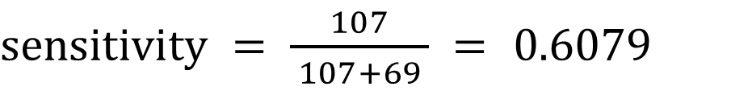
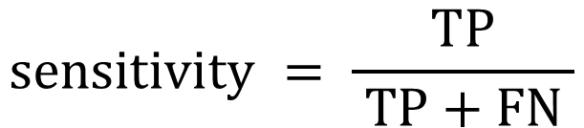
Sensitivity
Sensitivity:
What percentage of cats were correctly identified?
 |  | Actual
Predicted |  | Cat | Not cat
 | Cat | TP:107 | FP:23
 | Not cat | FN:69 | TN:42
$$sensitivity = \frac{TP}{ TP+FN }$$
$sensitivity = \frac{107}{ 107+69 } =$ 0.6079
60% of cats were identified as cats.
Notes:
The first metric is sensitivity, which is sometimes referred to as recall, hit rate, or true positive rate. This metric is the percentage of positive identifications. In the cat example, it represents what percentage of cats are correctly identified.
To calculate sensitivity, you take the number of true positives (positive identifications of cats) and divide that number by the total number of actual cats.

Slide 104

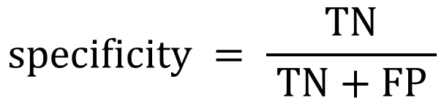
Specificity
Specificity:
What percentage of not cats were correctly identified?
 |  | Actual
Predicted |  | Cat | Not cat
 | Cat | TP:107 | FP:23
 | Not cat | FN:69 | TN:42
$$specificity = \frac{TN}{ TN+FP }$$
$specificity = \frac{42}{ 42+23 } =$ 0.6461
64% of not cats were identified as not cats
Notes:
Specificity, sometimes referred to as selectivity or true negative rate, is the percentage of negatives that were correctly identified. In the cat example, it is the number of images that were not cats that were identified as not cats.
To calculate specificity, you take the number of true negatives and divide that by the total number of actual negatives. In this example, that value is the number of not cats that were correctly identified, divided by the total number of actual not cats.

Slide 105
Which model is better now?
Model A
Model B
 |  | Actual
Predicted |  | Cat | Not cat
 | Cat | 107 | 23
 | Not cat | 69 | 42
 |  | Actual
Predicted |  | Cat | Not cat
 | Cat | 148 | 53
 | Not cat | 28 | 12
Sensitivity | 60%
Specificity | 64%
Sensitivity | 84%
Specificity | 18%
Notes:
Now that you have these metrics for each model, it is easier to decide what your business goal is.
Which model do you choose if you want to identify as many cats as possible? Model B is a good answer, if you are not concerned about many false positives—that is, not cats that were incorrectly identified.
Which model do you choose if you want to make sure that you identify animals that are not cats? Model A might work, depending upon how many false negatives you can handle.
If you are classifying patients that have heart disease or not, which model is best? This scenario is where it gets interesting. A fun website might get a bad reputation if it can’t identify cats correctly. However, if you are trying to diagnose patients, your focus might be different. It’s important to understand the tradeoffs.
You can use more metrics to help with your decision making.

Slide 106
Thresholds
Models return probabilities:
Predicted
0.96
0.77
0.58
0.01
0.47
It’s a cat!
if [predicted] >= threshold
if [predicted] < threshold
NOT cat!
Changing the threshold can change the prediction.
Notes:
Classification models are going to return a probability for the target. This probability is a value between 0 and 1 of the input that belongs to the target class. To convert the value to a class, you must determine the threshold to use. You might think that this threshold is 50 percent, but you might change that figure to be lower or higher to improve your results.
Like with sensitivity and specificity, classification involves a tradeoff between correctly and incorrectly identifying classes. Changing the threshold can affect the outcome. Next, you will look at how you can visualize this.

Slide 107
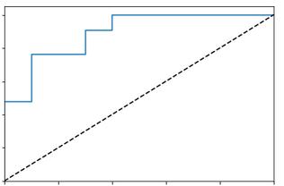
Classification: ROC graph
1.0
Receiver operating
characteristic (ROC)
0.8
0.6
Sensitivity
True-positive rate
Plot points for each threshold value
0.4
TPR = FPR
0.2
Select threshold based on business case
0.0
0.0
0.2
0.4
0.6
0.8
1.0
1 – Specificity
False-positive rate
Notes:
A receiver operating characteristic (ROC) graph summarizes all the confusion matrices that each threshold produced. To build one, you calculate the sensitivity (or true-positive rate) against the false-positive rate for each threshold value. You then plot this value on a graph. You can calculate the false-positive rate by subtracting the specificity from 1. When those points are plotted, you can draw a line between them.
The dotted black line from (0,0) to (1,1), which is the line that represents the sensitivity-to-TPR ratio, is equal to the false-positive rate.
The point at (1,1) means that you would have correctly identified all the cats, but also incorrectly identified all the not cats. This result is not good. Any point on this line means that the proportion of correctly classified samples is the same as the proportion of incorrectly classified samples.
The point at (0,0) represents zero true positives and zero false positives.
A model that has high sensitivity and a low false-positive rate is usually your goal. It’s better when the line between the threshold recordings is closer to the top-left corner.
If you have the data from two models, you can plot out the ROC curve for each model, and compare them. However, that can be tedious, so you can use the area under the curve (AUC)-ROC instead.

Slide 108
Classification: AUC-ROC
1.0
Area
under the
curve
0.8
0.6
Sensitivity
True-positive rate
AUC-ROC is used to easily compare one model to another
AUC: 89%
0.4
0.2
0.0
0.0
0.2
0.4
0.6
0.8
1.0
1-Specificity
False-positive rate
Notes:
Area under the curve-receiver operator curve (AUC-ROC) is another evaluation metric. The AUC part is the area under the plotted line. The higher the AUC, the better the model is at predicting cats as cats and not cats as not cats.
You can use the AUC to quickly compare models with each other.

Slide 109
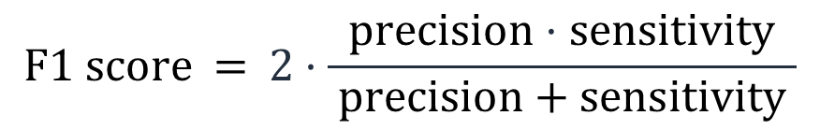
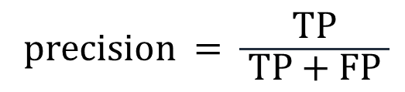
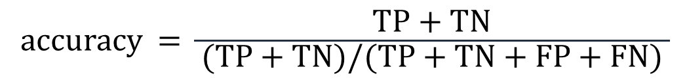
Classification: Other metrics
accuracy$\text{=} \frac{\text{TP}\text{ + }\text{TN}}{ \text{(}\text{TP}\text{ + }\text{TN}\text{)/(}\text{TP}\text{ + }\text{TN}\text{ + }\text{FP}\text{ + }\text{FN}\text{) }}$
Model’s score
precision = $\frac{\text{TP}}{ \text{TP}\text{ + }\text{FP} }$
Proportion of positive results that were correctly classified
$$\text{F}\text{1 }\text{score} \text{ =} 2·\frac{\text{precision}⋅\text{sensitivity}}{ \text{precision}\text{ + }\text{sensitivity} }$$
Combines precision and sensitivity
Notes:
With the four numbers from the confusion matrix, you can calculate the model’s accuracy (which is also known as its score). You can do this calculation by adding the correct predictions and then dividing that number by the total number of predictions.
Although accuracy is a widely used metric for classification problems, it has limitations. This metric is less effective when your dataset has many true negative cases. Think about the cat/not cat example. If the majority of your accuracy is based on true negatives, it says only that your model is good at predicting what isn’t a cat. In this case, you can’t feel confident in your model’s ability to predict cats when you roll it out into production.
This problem leads to the importance of ensuring that the metric you choose for model evaluation aligns with your business goal. Think about the credit card fraud example. Using accuracy as your main metric is probably not a good idea in this case, when you have many true negatives. Your high true-negative number might hide the fact that your model’s ability to identify cases of fraud (true positives) is not ideal. As a credit card company, it’s probably unacceptable to have less-than-almost-perfect performance in identifying fraud cases, because it would drive customers away. Such a result would be the opposite of what you want to achieve from a business standpoint.
For this reason, two other metrics are often used in these situations. The first one is precision, which removes the negative predictions from consideration. Precision is the proportion of positive predictions that are actually correct. You can calculate precision by taking the true positive and dividing it by the true positive plus the false positive.
When the cost of false positives is high in your particular business situation, precision might be a good metric. Think about a classification model that identifies emails as spam or not. You don’t want your model to label an email as spam when the email is legitimate. In that case, it would prevent your users from seeing that email, which might be important.
Consider a model that must predict whether a patient has a terminal illness or not. In this case, the use of precision as your evaluation metric doesn’t account for the false negatives in your model. It is vitally important and essential to the success of the model to identify the illness in a patient who actually has that illness. In this situation, sensitivity is a better metric to use.
However, it doesn’t always need to be one or the other. The F1 score combines precision and sensitivity to give you one number that quantifies the overall performance of a particular ML algorithm. You might want to use the F1 score when you have a class imbalance, but you want to preserve the equality between precision and sensitivity.

Slide 110
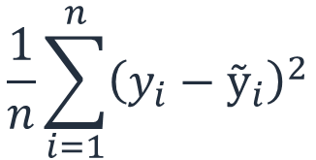
Regression: Mean squared error
(x6,y6)
(x4,y4)
(x3,y3)
$$\frac{1}{n}\sum_{i=1}^{n}{{\left(y_{i}−ỹ_{i}\right)}^{2}}$$
MSE =
y
(x1,y1)
(x5,y5)
(x7,y7)
(x2,y2)
x
Notes:
But what if you are dealing with a regression problem? In that case, you can use other common metrics to evaluate your model, including mean squared error.
Mean squared error is commonly used. Its general purpose is the same as what you saw with classification metrics. You determine the prediction from the model, and you compare the difference between the prediction and the actual outcome.
More specifically, you take the difference between the prediction and actual value, square that difference, and then add all the squared differences for all the observations. In scikit-learn, you can use the mean squared error function directly from the metrics library.
You can use other metrics for linear models, including R squared.

Slide 111
ML tuning process
Tune model
Meets business goal?
Feature engineering
Select and train model
Evaluate model
No
Feature augmentation
Notes:
You have trained your model, performed a batch transformation on your test data, and calculated your metrics. Now, you can use these metrics to help you tune the model. You might select a different set of features and train the model again. Which was the better model? The metrics can help to inform you. You might also use different data and retrain the model with the same features. Recall the k-fold cross validation. Finally, you might tune the parameters of the model itself, which is the subject of the next section.

Slide 112
Module 3 – Guided Lab 6: Evaluating Model Accuracy
Notes:
You will now complete Lab 6: Evaluating Model Accuracy.

Slide 113
Section 7 key takeaways
Several ways to validate the model
Hold-out
K-fold cross validation
Two types of model evaluation
Classification
Confusion matrix
AUC-ROC
Regression testing
Mean squared
Notes:
Some key takeaways from this section of the module include:
To evaluate the model, you must have data that the model hasn’t seen, through either a hold-out set or by using k-fold cross validation.
Different machine learning models use different metrics.
Classification can use confusion matrix, and the AUC-ROC that can be generated from it.
Regression can use mean squared.

Slide 114
Section 8: Hyperparameter and model tuning
Module 3: Implementing a Machine Learning Pipeline with Amazon SageMaker
Notes:
Introducing Section 8: Hyperparameter and model tuning

Slide 115
Machine learning pipeline
New data and retraining
Deploy model
Business problem
Problem formulation
Tune model
Yes
Meets business goal?
Collect and label data
Evaluate data
Feature engineering
Select and train model
Evaluate model
No
Feature augmentation
Data augmentation
Notes:
In this section, you will learn how to tune the model’s hyperparameters to improve model performance.

Slide 116
Recap: Goal for models
Balanced and generalizes well
Notes:
Recall from an earlier module that hyperparameters can be thought of as the knobs that tune the machine learning algorithm to improve its performance. Now, you will look more explicitly at tuning your models. You will learn more specific details about the types of hyperparameters and how to optimize hyperparameters.

Slide 117
Hyperparameter categories
Model
Help define the model
Filter size, pooling, stride, padding
Optimizer
How the model learns patterns on data
Gradient descent, stochastic gradient descent
Data
Define attributes of the data itself
Useful for small or homogenous datasets
Notes:
Hyperparameters have a few different categories. The first kind is model hyperparameters, which help define the model itself. For instance, some neural-network-based models require you to define an architecture before you can start training them. The architecture includes a specific number of layers in the neural network and the activation functions that are used within. For example, in a neural network for a computer vision problem, additional attributes of the architecture must be defined. Such attributes include filter size, pooling, and the stride or padding.
The second kind is optimizer hyperparameters. These hyperparameters are related to how the model learns the patterns that are based on data, and they are used for a neural-network model. These types of hyperparameters include optimizers like gradient descent and stochastic gradient descent. They can also include optimizers that use momentum like Adam, or initialize the parameter weights by using methods such as Xavier initialization or He initialization.
The third kind is data hyperparameters, which relate to the attributes of the data itself. They include attributes that define different data augmentation techniques, such as cropping or resizing for image-related problems. They are often used when you don’t have enough data or enough variation in your data.

Slide 118
Tuning hyperparameters
Manually select hyperparameters according to one’s intuition or experience
However, this approach is often not as thorough or efficient as needed
Notes:
Tuning hyperparameters can be labor-intensive. Traditionally, this kind of tuning was done manually. Someone—who had domain experience that was related to that hyperparameter and use case—would manually select the hyperparameters, according to their intuition and experience. Then, they would train the model and score it on the validation data. This process would be repeated until satisfactory results were achieved.
This process is not always the most thorough and efficient way of tuning your hyperparameters.

Slide 119
Amazon SageMaker offers automated hyperparameter tuning
Clients
(console, notebook, IDEs, AWS CLI)
Hyperparameter tuning job
Training job
Training job
Tuning strategy
Objective metric: Area under the curve
Training job
Notes:
Amazon SageMaker enables you to perform automated hyperparameter tuning. Amazon SageMaker automatic model tuning, also known as hyperparameter tuning, finds the best version of a model by running many training jobs on your dataset. It uses the algorithm and ranges of hyperparameters that you specify. It then chooses the hyperparameter values that result in a model that performs the best, as measured by a metric that you choose. It uses Gaussian Process regression to predict which hyperparameter values might be most effective at improving fit. It also uses Bayesian optimization to balance exploring the hyperparameter space and exploiting specific hyperparameter values, when appropriate. And importantly, automatic model tuning can be used with the Amazon SageMaker built-in algorithms, prebuilt deep learning frameworks, and bring-your-own-algorithm containers.

Slide 120
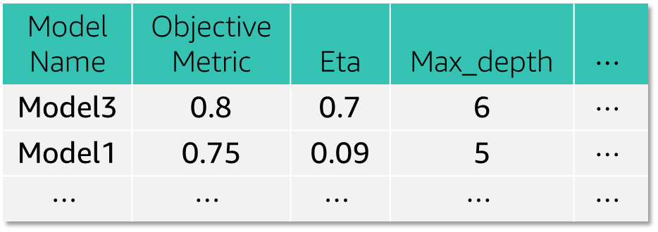
Automated hyperparameter tuning
Clients
(console, notebook, IDEs, AWS CLI)
Hyperparameter tuning job
Training job
Model Name | Objective Metric | Eta | Max_depth | $$⋯$$
Model3 | 0.8 | 0.7 | 6 | $$⋯$$
Model1 | 0.75 | 0.09 | 5 | $$⋯$$
$$⋯$$ | $$⋯$$ | $$⋯$$ | $$⋯$$ | $$⋯$$
Training job
Tuning strategy
Objective metric: Area under the curve
Training job
Notes:
For example, suppose that you want to solve a binary classification problem on a fraud dataset. Your goal is to maximize the area under the curve (AUC) metric of the algorithm by training a linear learner algorithm model. You don't know which values of the learning_rate, beta_1, beta_2, and epochs to use to train the best model.
To find the best values for these hyperparameters, you can specify ranges of values for Amazon SageMaker hyperparameter tuning to search. It uses these ranges to run training jobs so it can find the combination of values that performs the best, as measured by the objective metric that you chose. It will then return the training job with the highest AUC.

Slide 121
Hyperparameter tuning
Note: Tuning doesn’t always improve your model.
Notes:
Hyperparameter tuning might not necessarily improve your model. It’s an advanced tool for building machine solutions. As such, it should be considered part of the process of using the scientific method. When you build complex ML systems like deep learning neural networks, it is impractical to explore all the possible combinations.

Slide 122
Tuning best practices
Don’t adjust every hyperparameter
Limit your range of values to what’s most effective
Run one training job at a time instead of multiple jobs in parallel
In distributed training jobs, make sure that the objective metric that you want is the one that is reported back
With Amazon SageMaker, convert log-scaled hyperparameters to linear-scaled when possible
Notes:
To improve optimization, use the following guidelines when you create hyperparameters.
Limit the number of hyperparameters to the ones that you think are most likely to give you good results, instead of using all hyperparameters.
The range of values for hyperparameters that you choose to search can significantly affect the success of hyperparameter optimization. You might want to specify a large range that covers every possible value for a hyperparameter. However, you get better results by limiting your search to a small range of values. If you get the best metric values within a part of a range, consider limiting the range to that part.
Running more hyperparameter tuning jobs concurrently gets more work done quickly, but a tuning job improves only through successive rounds of experiments. Typically, running one training job at a time achieves the best results with the least amount of compute time.
When a training job runs on multiple instances, hyperparameter tuning takes the last-reported objective metric from all instances of that training job. It then uses that metric as the value of the objective metric for that training job. You should design distributed training jobs so that you get the report of the objective metric that you want.
During hyperparameter tuning, Amazon SageMaker attempts to determine whether your hyperparameters are log-scaled or linear-scaled. Initially, it assumes that hyperparameters are linear-scaled. If they should be log-scaled, it might take some time for Amazon SageMaker to discover it. If you know that a hyperparameter should be log-scaled and can convert it yourself, doing so can improve hyperparameter optimization.

Slide 123
Demonstration: Optimizing Amazon SageMaker Hyperparameters
Notes:
Your instructor will now either demonstrate how to optimize Amazon SageMaker hyperparameters or provide you with access to the recorded demonstration..

Slide 124
Amazon SageMaker Autopilot
Inputs
Outputs
Amazon SageMaker Autopilot
Analyze data
Test data
Trained models
Feature engineering
Training data
y
Model tuning
Model metrics
data
Target
Notes:
Now that you have walked through the end-to-end process of training and tuning an ML model, it’s worth learning about Amazon SageMaker Autopilot. This service can help you find a good model, with little effort or input from you. With Autopilot, you create a job that supplies the test, training, and target. Autopilot analyzes the data, selects appropriate features, and then trains and tunes models. It documents the metrics and finds the best model that is based on the provided data. The results include the winning model, metrics, and a Jupyter notebook that you can use to investigate the results. This service doesn’t remove your need to perform preprocessing of the data, but it can save time in feature selection and model tuning.

Slide 125
Demonstration: Running Amazon SageMaker Autopilot
Notes:
Your instructor will now either demonstrate how to run Amazon SageMaker Autopilot or provide you with access to the recorded demonstration.

Slide 126
Module 3 – Guided Lab 7: Tuning with Amazon SageMaker
Notes:
You will now complete Module 3 – Guided Lab 7: Tuning with Amazon SageMaker.

Slide 127
Section 8 key takeaways
Model tuning helps find the best solution
Hyperparameters
Model
Optimizer
Data
Tuning
Use Amazon SageMaker to help tune hyperparameters
Use Autopilot for faster development
Notes:
Some key takeaways from this section of the module include:
Model tuning is important to find the best solution to your business problem.
Hyperparameters can be tuned for the model, optimizer, and data.
Amazon SageMaker can perform automatic hyperparameter tuning.
Overall model development can be accelerated by using Autopilot.

Slide 128
Module wrap-up
Module 3: Implementing a Machine Learning Pipeline with Amazon SageMaker
Notes:
It is now time to review the module and wrap up with a knowledge check.

Slide 129
Module summary
In this module, you learned how to:
Formulate a problem from a business request
Obtain and secure data for machine learning (ML)
Build a Jupyter Notebook by using Amazon SageMaker
Outline the process for evaluating data
Explain why data must be preprocessed
Use open source tools to examine and preprocess data
Use Amazon SageMaker to train and host an ML model
Use cross-validation to test the performance of an ML model
Use a hosted model for inference
Create an Amazon SageMaker hyperparameter tuning job to optimize a model’s effectiveness
Notes:
In summary, in this module, you learned how to:
Formulate a problem from a business request
Obtain and secure data for machine learning (ML)
Build a Jupyter Notebook by using Amazon SageMaker
Outline the process for evaluating data
Explain why data must be preprocessed
Use open source tools to examine and preprocess data
Use Amazon SageMaker to train and host an ML model
Use cross-validation to test the performance of an ML model
Use a hosted model for inference
Create an Amazon SageMaker hyperparameter tuning job to optimize a model’s effectiveness

Slide 130
Complete the knowledge check
Notes:
It is now time to complete the knowledge check for this module.

Slide 131
Additional resources
<Add URLs to resources that students might find helpful for further exploration on topics discussed in this module.>
<Especially, link to whitepapers or other resources mentioned in the Exam Guide of the certification exam this course is intended to help students prepare for.>
Notes:
If you want to learn more about the topics that are covered in this module, you might find the following additional resources helpful:
<insert hyperlink>

Slide 132
Thank you
Notes:
Thank you for completing this module.

